Slide 1
Safety Test Modes Reference
One Slide Per Test Mode | Comprehensive Technical Guide

Slide 2
SECTION 1: NHTSA / FMVSS REGULATORY TESTS
Tests in This Section:
1. FMVSS 208 - Full Frontal Impact
2. FMVSS 214 - Side Impact (MDB)
3. FMVSS 214 - Side Pole Impact
4. FMVSS 216 - Roof Crush Resistance
5. FMVSS 301 - Fuel System Integrity
6. FMVSS 208 - Out-of-Position (OOP)
7. FMVSS 213 - Child Restraint Systems
8. FMVSS 201 - Interior Impact (FMH)

Slide 3
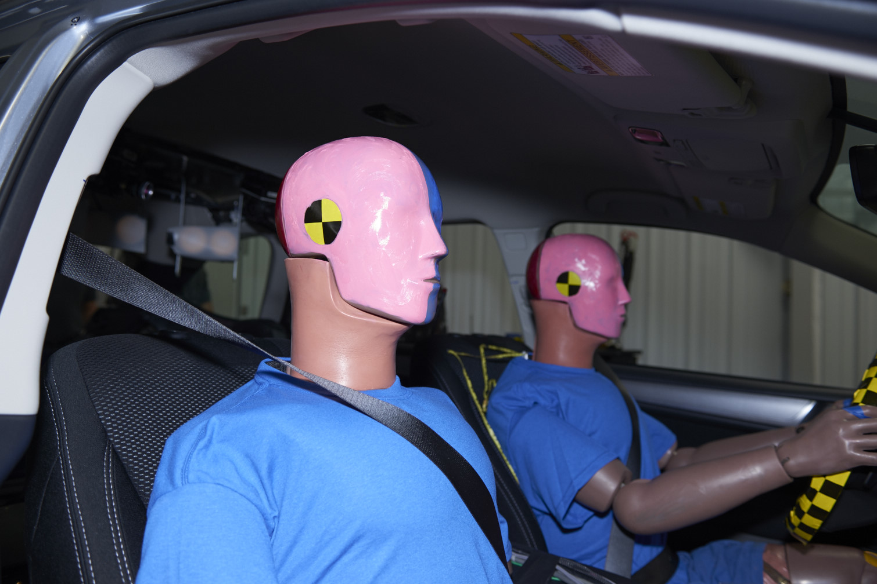
FMVSS 208 - Full Frontal Impact
NHTSA | 1968/1984
Full Vehicle Crash Test
PURPOSE
Evaluates occupant protection in head-on collisions. The most fundamental crash test - simulates striking a fixed barrier at highway speed. Forms the basis of NCAP 5-star ratings.
TEST SETUP
DUMMY & INSTRUMENTATION
Speed: 35 mph (56 km/h)
Barrier: Rigid concrete wall
Overlap: 100% full width
Vehicle: Production vehicle
Orientation: Perpendicular
Driver ATD: Hybrid III 50th male
Passenger ATD: Hybrid III 5th female
Total Channels: ~94
Key Sensors: Head accel, chest, femur
INJURY CRITERIA & LIMITS
HIC15: ≤ 700 (Head)
Chest Accel (3ms): ≤ 60g (Thorax)
Chest Deflection: ≤ 63mm / 52mm (Thorax)
Femur Load: ≤ 10 kN (Lower Ext)
Nij: ≤ 1.0 (Neck)
Neck Tension: ≤ 4,170 N (Neck)

Slide 4
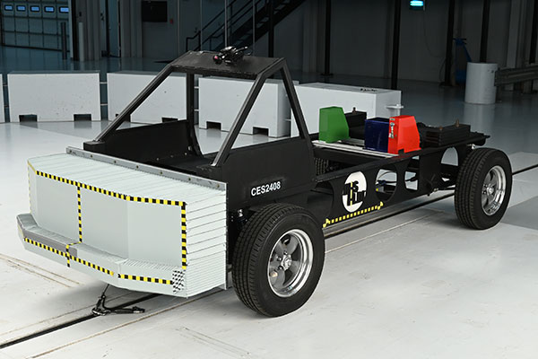
FMVSS 214 - Side Impact (MDB)
NHTSA | 1990
Full Vehicle Crash Test
PURPOSE
Evaluates occupant protection when struck broadside. Side impacts are particularly dangerous - only inches separate the door from the occupant.
TEST SETUP
DUMMY & INSTRUMENTATION
MDB Speed: 33.5 mph (54 km/h)
MDB Mass: 3,015 lb (1,368 kg)
Angle: 27° crabbed
Impact Point: Driver side, H-point
Barrier Face: Deformable honeycomb
Driver ATD: ES-2re
Rear ATD: SID-IIs (5th female)
Total Channels: ~80
Key Sensors: Ribs, pelvis, abdomen
INJURY CRITERIA & LIMITS
HIC36: ≤ 1000 (Head)
Rib Deflection: ≤ 44 mm (Thorax)
Lower Spine Accel: ≤ 82g (Pelvis)
Abdominal Force: ≤ 2.5 kN (Abdomen)
Pubic Force: ≤ 6 kN (Pelvis)
V*C: ≤ 1.0 m/s (Thorax)

Slide 5
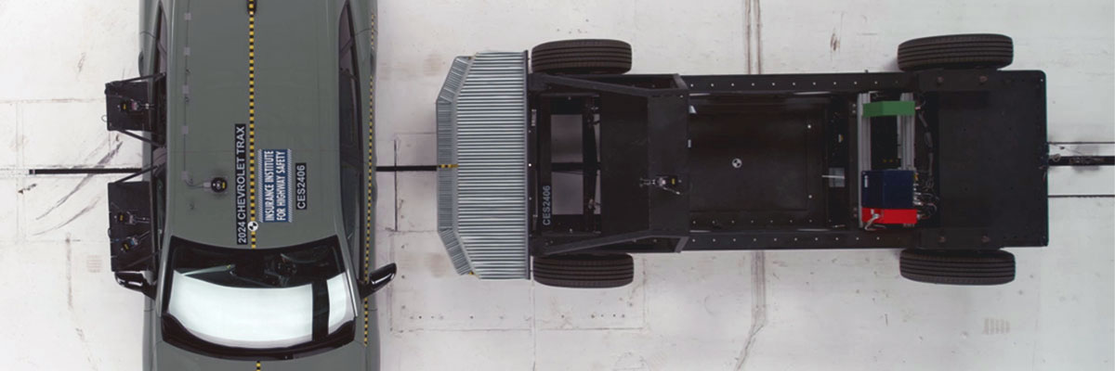
FMVSS 214 - Side Pole Impact
NHTSA | 2007
Full Vehicle Crash Test
PURPOSE
Simulates sliding sideways into a narrow object (tree, pole). Concentrates force on small area, causing severe intrusion. Side curtain airbags critical.
TEST SETUP
DUMMY & INSTRUMENTATION
Speed: 20 mph (32 km/h)
Pole Diameter: 254 mm (10 in)
Impact Angle: 75° oblique
Impact Location: Driver head position
Vehicle: Propelled into pole
Driver ATD: ES-2re or WorldSID
Total Channels: ~40
Key Sensors: Head, ribs, pelvis
INJURY CRITERIA & LIMITS
HIC36: ≤ 1000 (Head)
Rib Deflection: ≤ 44 mm (Thorax)
Lower Spine Accel: ≤ 82g (Pelvis)
Abdominal Force: ≤ 2.5 kN (Abdomen)
Note: Side curtain airbags became essential for passing this test.

Slide 6
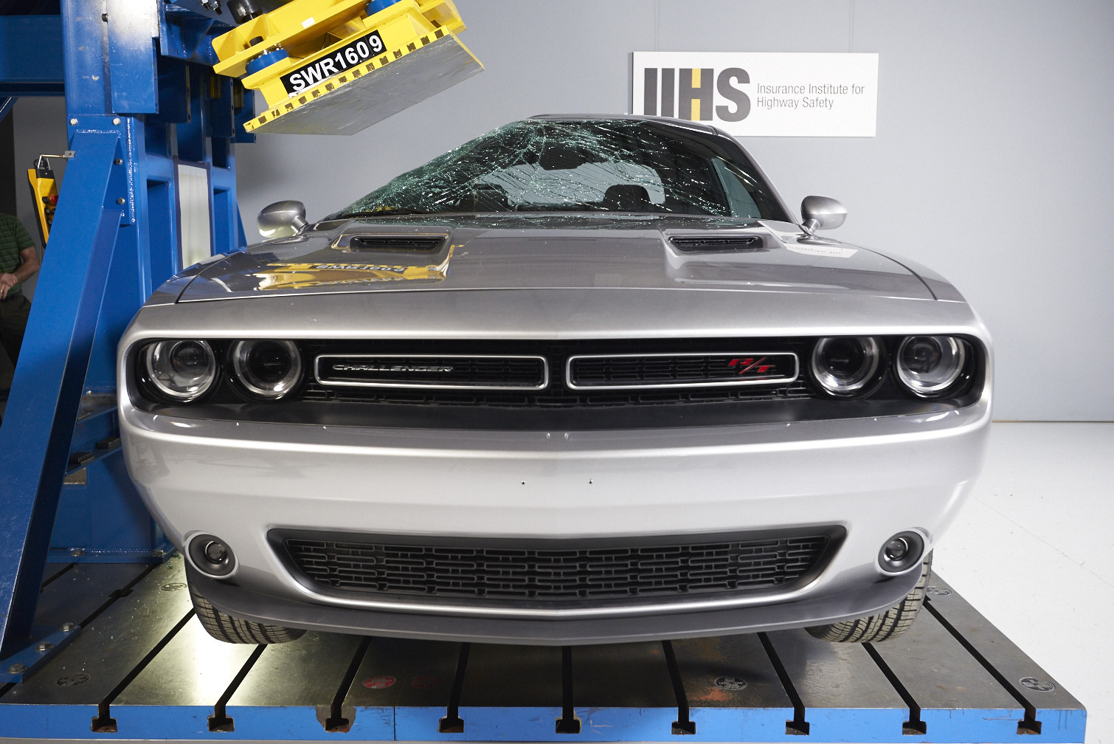
FMVSS 216 - Roof Crush Resistance
NHTSA | 1973/2009
Static Test
PURPOSE
Ensures roof supports vehicle weight during rollover. 2009 upgrade doubled requirement to 3x after Ford/Firestone crisis showed original 1.5x inadequate.
TEST SETUP
DUMMY & INSTRUMENTATION
Test Type: Static (no crash)
Force Application: Angled steel plate
Plate Angle: 25° from horizontal
Force Required: ≥ 3× vehicle weight
Duration: 5 seconds
ATD: None (static test)
Measurements: Force, displacement
Channels: ~4-6
Key Sensors: Load cells
INJURY CRITERIA & LIMITS
Strength-to-Weight: ≥ 3.0 (Structure)
Max Displacement: ≤ 127 mm (Before 3×)
Both Sides: Must pass (Independent)
Note: Original 1.5× standard (1973) doubled to 3× in 2009.

Slide 7
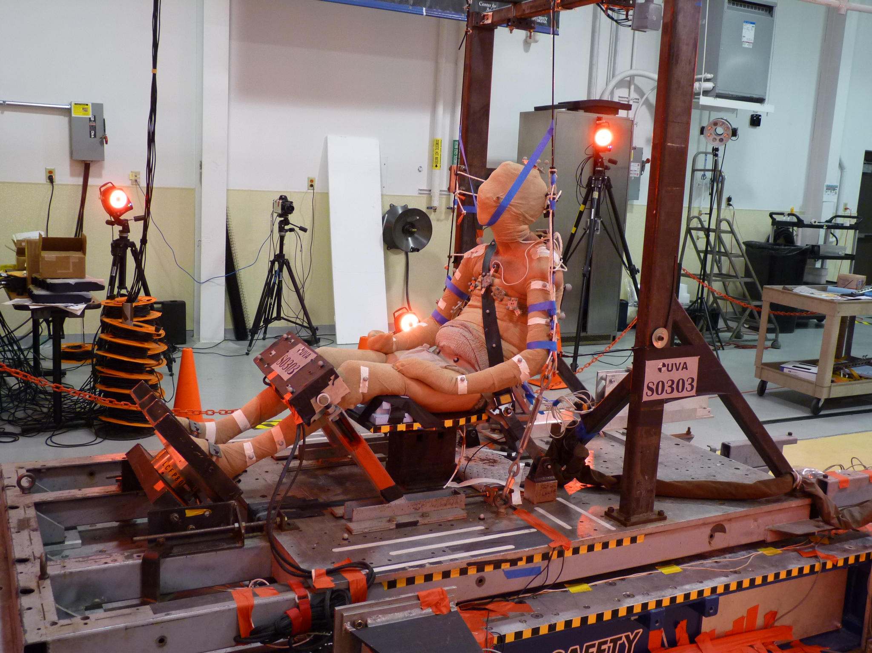
FMVSS 301 - Fuel System Integrity
NHTSA | 1968/1977
Full Vehicle Crash Test
PURPOSE
Prevents fuel leakage after crashes to reduce fire risk. Strengthened in 1977 after infamous Ford Pinto case showed $11 fix vs. deaths calculation.
TEST SETUP
DUMMY & INSTRUMENTATION
Rear Speed: 50 mph MDB
Side Speed: 20 mph MDB
Rollover: 360° rotation
MDB Mass: 4,000 lb
Duration: 5 min post-crash
ATD: None (leakage test)
Measurements: Fuel leakage volume
Duration: 5 minutes static
INJURY CRITERIA & LIMITS
Impact Leakage: ≤ 28g (During crash)
Static Leakage: ≤ 142g/min (Post-crash)
Rollover Leakage: ≤ 142g/min (Each position)
Note: Ford Pinto: 'Cheaper to let them burn' memo became infamous.

Slide 8
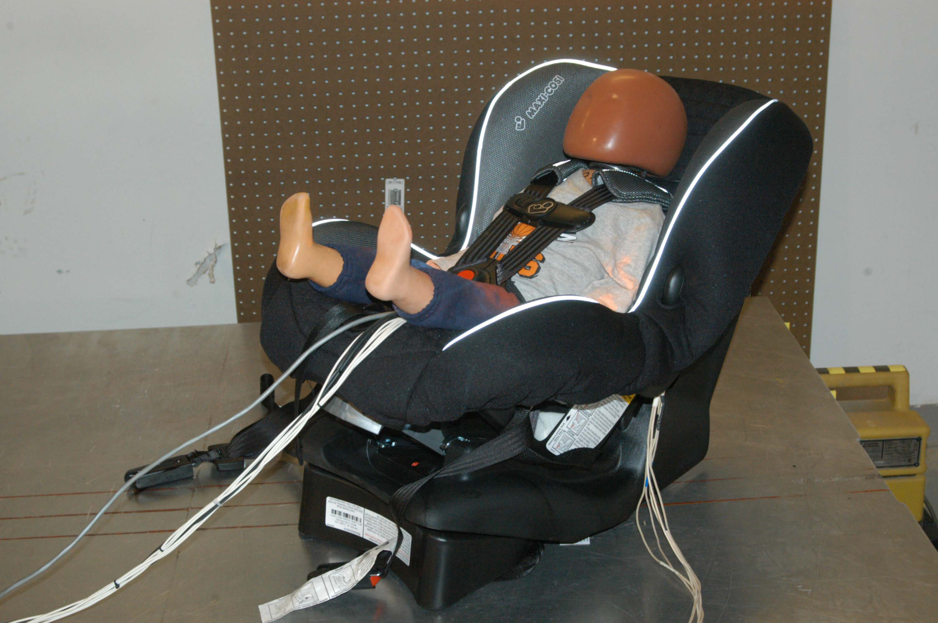
FMVSS 208 - Out-of-Position (OOP)
NHTSA | 2000
Static Deployment Test
PURPOSE
Ensures airbags don't injure occupants too close at deployment. Added after 175+ deaths from early aggressive airbags (mostly children and small adults).
TEST SETUP
DUMMY & INSTRUMENTATION
Position 1: Chin on module
Position 2: Chest on module
Position 3: Abdomen on module
Position 4: Child seat present
Test: Airbag deployment
ATDs Used: 5th female, children
Children: 6yr, 3yr, 12mo CRABI
Total Channels: ~30 per test
Key Sensors: Head/neck, chest
INJURY CRITERIA & LIMITS
HIC15: ≤ 700 (Head)
Nij: ≤ 1.0 (Neck)
Neck Tension: ≤ 2,620 N (Neck (5th))
Chest Deflection: ≤ 52 mm (Thorax (5th))
Note: Led to multi-stage airbags and suppression systems.

Slide 9
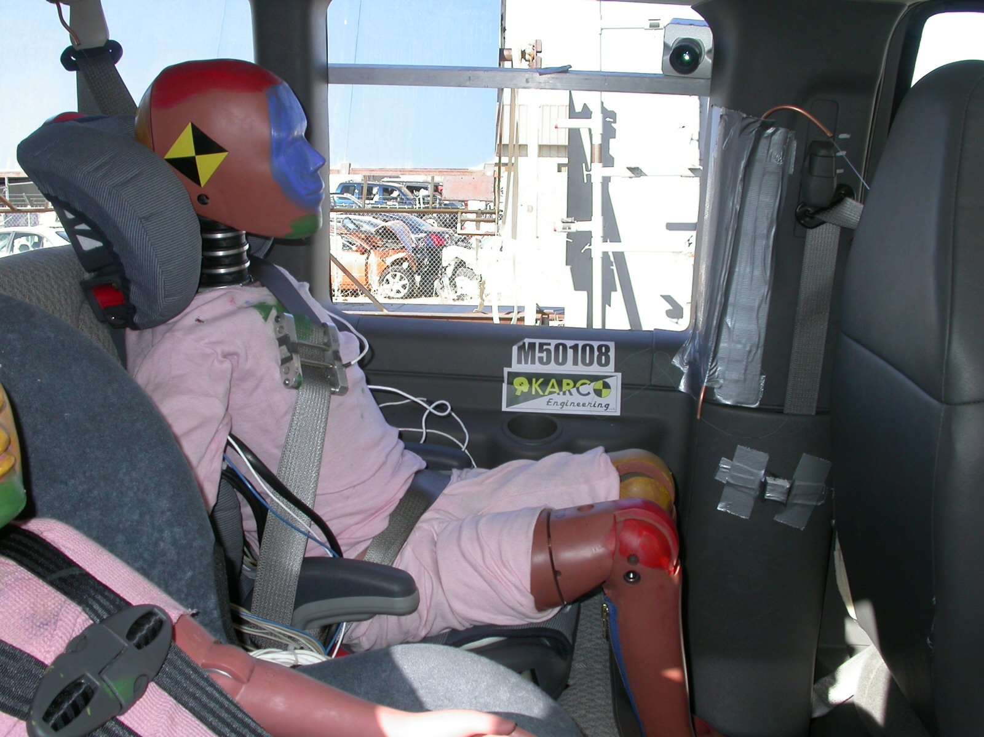
FMVSS 213 - Child Restraint Systems
NHTSA | 1971
Sled Test
PURPOSE
Ensures child car seats protect children in crashes. Tests the child restraint system itself, not the vehicle. Multiple dummy sizes used.
TEST SETUP
DUMMY & INSTRUMENTATION
Test Type: Sled test
Delta-V: 30 mph (48 km/h)
Peak G: 23-26g
Pulse Duration: ~80 ms
Seat Bench: Standardized
Dummies: CRABI, HIII 3/6/10 yr
Total Channels: ~15-20 per dummy
Key Sensors: Head accel, excursion
INJURY CRITERIA & LIMITS
HIC36: ≤ 1000 (All dummies)
Head Excursion: ≤ 720 mm (Forward)
Knee Excursion: ≤ 915 mm (Forward)
Chest Accel (3ms): ≤ 60g (All)

Slide 10
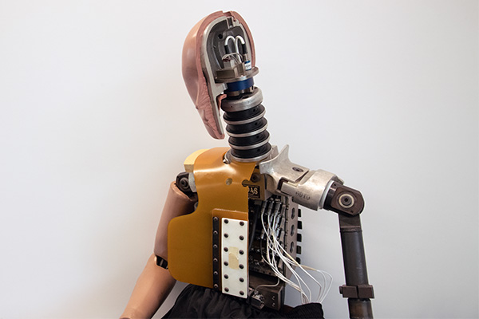
FMVSS 201 - Interior Impact (FMH)
NHTSA | 1968/1998
Component Test
PURPOSE
Ensures interior surfaces (pillars, header) don't cause severe head injury when struck. Led to padded pillars and roof-mounted airbags.
TEST SETUP
DUMMY & INSTRUMENTATION
Test Type: Component test
Impactor: Free Motion Headform
FMH Mass: 4.5 kg (10 lb)
Impact Speed: 15 mph (24 km/h)
Targets: A/B/C pillars, header
FMH Sensors: Triaxial accelerometer
Total Channels: 3
Sample Rate: ≥ 8,000 Hz
Filter: CFC 1000
INJURY CRITERIA & LIMITS
HIC(d): ≤ 1000 (All points)
Note: Multiple impact points tested across each pillar.

Slide 11
SECTION 2: IIHS CONSUMER INFORMATION TESTS
Tests in This Section:
1. IIHS Moderate Overlap Frontal
2. IIHS Small Overlap Frontal
3. IIHS Side Impact (2021 Updated)
4. IIHS Roof Strength
5. IIHS Head Restraint / Whiplash (Discontinued)
6. IIHS Front Crash Prevention - V2V
7. IIHS Headlights
8. IIHS Front Crash Prevention - Pedestrian

Slide 12
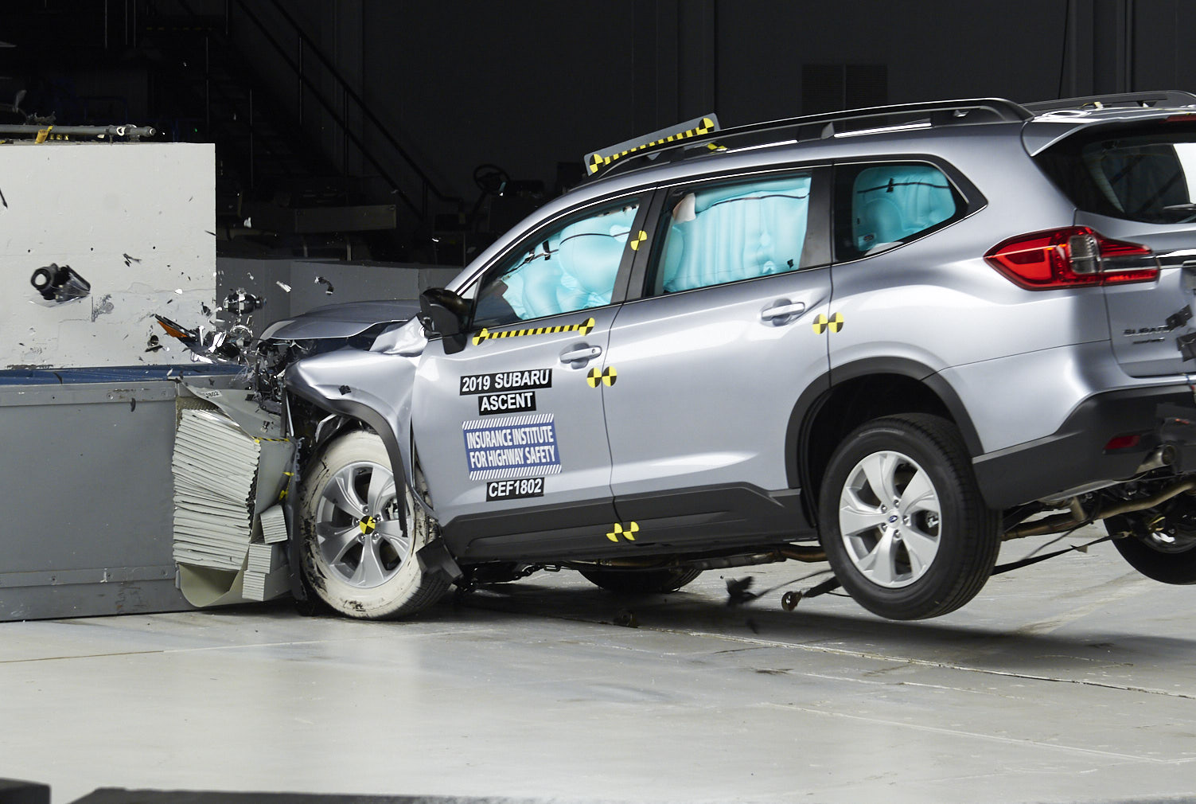
IIHS Moderate Overlap Frontal
IIHS | 1995
Full Vehicle Crash Test
PURPOSE
Simulates head-on crash with partial engagement - the most common serious frontal crash. More demanding than FMVSS 208 because it bypasses part of crush structure.
TEST SETUP
DUMMY & INSTRUMENTATION
Speed: 40 mph (64 km/h)
Overlap: 40% of width
Barrier: Deformable honeycomb
Barrier Height: 650 mm
Barrier Width: 1,000 mm
Driver ATD: Hybrid III 50th male
Total Channels: ~47
Key Sensors: Head, neck, chest, legs
INJURY CRITERIA & LIMITS
Head/Neck: Good/Acceptable/Marginal/Poor (Risk level)
Chest: Good/Acceptable/Marginal/Poor (Risk level)
Hip/Thigh: Good/Acceptable/Marginal/Poor (Risk level)
Lower Leg: Good/Acceptable/Marginal/Poor (Risk level)

Slide 13
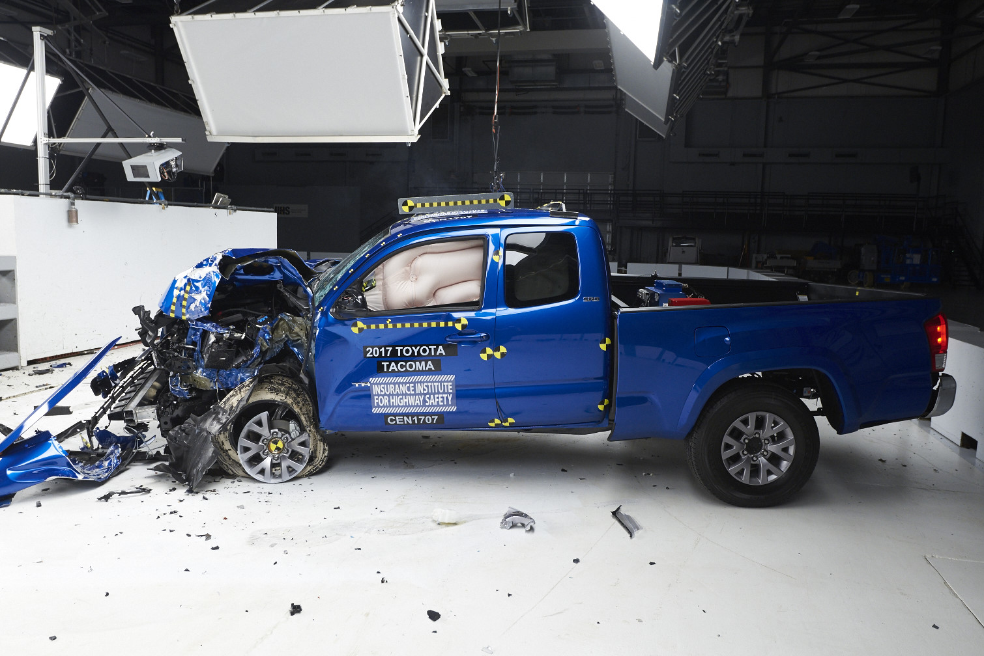
IIHS Small Overlap Frontal
IIHS | 2012/2017
Full Vehicle Crash Test
PURPOSE
Addresses corner impacts (tree, pole). Many vehicles that aced moderate overlap failed initially - BMW, Mercedes, Audi all rated Marginal/Poor in 2012.
TEST SETUP
DUMMY & INSTRUMENTATION
Speed: 40 mph (64 km/h)
Overlap: 25% of width
Barrier: RIGID (not deformable)
Tests: Driver AND Passenger sides
Barrier Edge: Rounded
ATD: Hybrid III 50th male
Total Channels: ~47
Key Sensors: Head, neck, chest, legs
INJURY CRITERIA & LIMITS
Structure: Intrusion measured (Compartment)
Kinematics: Stayed in zone? (Restraint)
Injury Risk: G/A/M/P (All regions)
Note: 2012 launch: Only 3 of 13 midsize cars earned 'Good'.

Slide 14
IIHS Side Impact (2021 Updated)
IIHS | 2003/2021
Full Vehicle Crash Test
PURPOSE
Simulates T-bone by larger SUV. 2021 update: heavier barrier (4,200 lb vs 3,300 lb) and faster (37 mph vs 31 mph) to reflect real-world vehicle size increases.
TEST SETUP
DUMMY & INSTRUMENTATION
Barrier Speed: 37 mph (2021)
Barrier Mass: 4,200 lb (2021)
Ground Clearance: Higher (SUV-like)
Face Height: Taller
Impact: Driver side
Front ATD: SID-IIs (5th female)
Rear ATD: SID-IIs (5th female)
Total Channels: ~60
Key Sensors: Head, ribs, pelvis
INJURY CRITERIA & LIMITS
Head/Neck: G/A/M/P (HIC, accel)
Torso: G/A/M/P (Rib deflection)
Pelvis: G/A/M/P (Accel, pubic)
Note: Original (2003): 31 mph, 3,300 lb barrier.

Slide 15
IIHS Roof Strength
IIHS | 2009
Static Test
PURPOSE
Evaluates roof strength for rollover. IIHS 'Good' requires 4× vehicle weight - exceeds federal 3× requirement. Most vehicles now earn Good.
TEST SETUP
DUMMY & INSTRUMENTATION
Test Type: Static loading
Plate Angle: 25°
Loading Rate: ≤ 5 mm/sec
Crush Limit: 127 mm
Both Sides: Tested separately
ATD: None
Measurements: Force, displacement
INJURY CRITERIA & LIMITS
Good: ≥ 4.0× (Strength-to-weight)
Acceptable: 3.25 - 3.99× (Strength-to-weight)
Marginal: 2.50 - 3.24× (Strength-to-weight)
Poor: < 2.50× (Strength-to-weight)
Note: Discontinued after 2016 - nearly all vehicles earn Good.

Slide 16
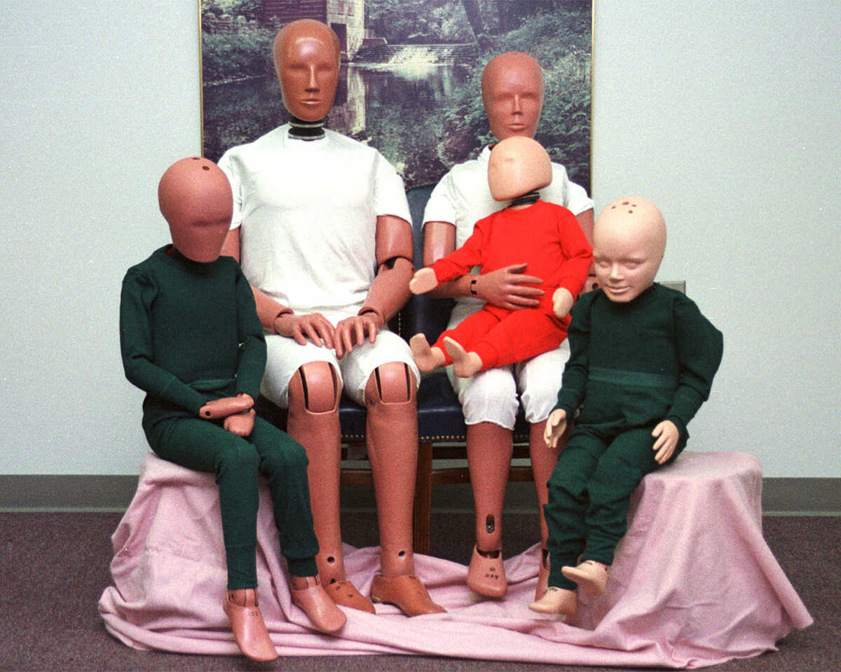
IIHS Head Restraint / Whiplash
IIHS | 2004-2020
Sled Test (DISCONTINUED)
PURPOSE
Evaluated whiplash protection in rear-end crashes. Used BioRID II dummy with 24-vertebrae spine. Discontinued because nearly all seats now earn Good.
TEST SETUP
DUMMY & INSTRUMENTATION
Test Type: Sled test
Delta-V: 10 mph (16 km/h)
Peak Accel: ~10g
Pulse: Rear-end simulated
Status: DISCONTINUED 2020
ATD: BioRID II
Special: 24-vertebrae spine
Total Channels: ~35
Key Sensors: Neck, spine motion
INJURY CRITERIA & LIMITS
Contact Time: How quickly head reached restraint (Timing)
Torso Accel: Peak acceleration (Severity)
Neck Shear: Maximum force (Injury risk)
Neck Tension: Maximum force (Injury risk)
Note: IIHS developing more demanding rear-impact test.

Slide 17
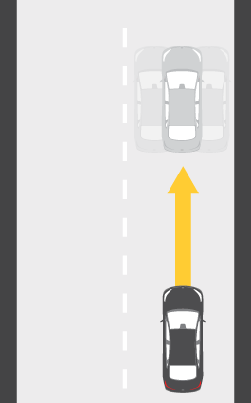
IIHS Front Crash Prevention - V2V
IIHS | 2013
Track Test
PURPOSE
Evaluates AEB and FCW systems. Tests response to passenger cars, motorcycles, and semi-trailers. Points for warnings and speed reductions.
TEST SETUP
DUMMY & INSTRUMENTATION
Targets: Car, motorcycle, trailer
Speeds: 31, 37, 43 mph
Car Config: Centered and offset
Motorcycle: Centered and offset
Semi: FCW only (steer out)
Instrumentation: GPS, speed, decel
FCW Timing: ≥ 2.1 sec required
AEB Weight: 2/3 of score
FCW Weight: 1/3 of score
INJURY CRITERIA & LIMITS
Full Avoidance: Maximum points (AEB)
Speed Reduction: Partial points (AEB)
Warning ≥2.1s: Required (FCW)

Slide 18
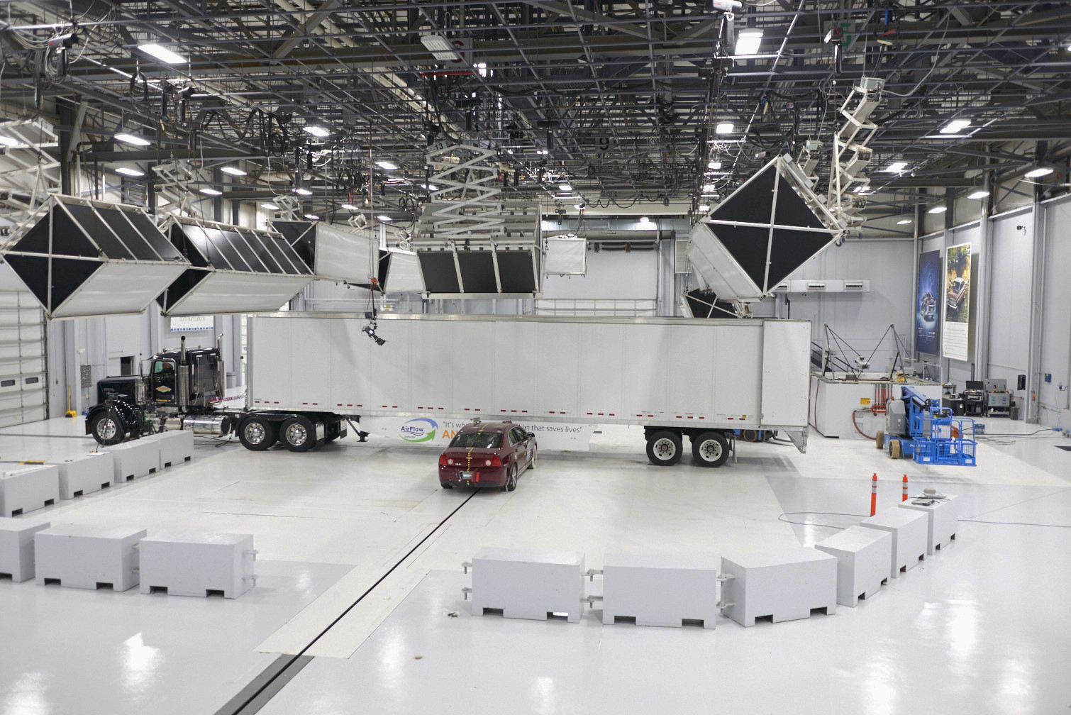
IIHS Headlights
IIHS | 2016
Track Evaluation
PURPOSE
Evaluates headlight illumination and glare. Revealed huge variation - some 'luxury' vehicles had poor headlights. Tests straights and curves.
TEST SETUP
DUMMY & INSTRUMENTATION
Track: Straight and curved
Curves: 500ft, 800ft radius
Measurements: Light intensity
Conditions: Nighttime, dry
High Beam: Auto-assist evaluated
Instrumentation: Light meters
Measurements: Illumination distance
Factors: Low beam, high beam, glare
INJURY CRITERIA & LIMITS
Low Beam Straight: Primary factor (Distance)
Low Beam Curves: Critical (Safety)
High Beam: Additional credit (Bonus)
Excessive Glare: Deductions (Penalty)
Note: Wide variation even within same model (trim levels).

Slide 19
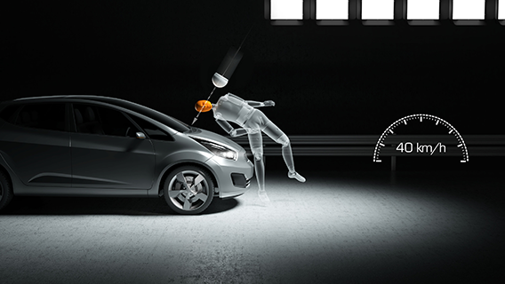
IIHS Front Crash Prevention - Pedestrian
IIHS | 2019
Track Test
PURPOSE
Evaluates AEB for pedestrian detection. Pedestrian fatalities increased as SUV sales grew. Tests adult and child crossing scenarios.
TEST SETUP
DUMMY & INSTRUMENTATION
Adult Perp: 50th male crossing
Adult Parallel: Walking along edge
Child: Darting into road
Speeds: 25, 37 mph
Conditions: Daytime
Targets: Adult/child body forms
Movement: Propelled on track
Instrumentation: Speed, braking
INJURY CRITERIA & LIMITS
Superior: Avoid/reduce all scenarios (Rating)
Advanced: Significant reduction (Rating)
Basic: Warning only (Rating)
Note: Euro NCAP added night testing in 2024.

Slide 20
SECTION 3: NCAP CONSUMER RATING TESTS
Tests in This Section:
1. NHTSA NCAP 5-Star Frontal
2. NHTSA NCAP 5-Star Side
3. Euro NCAP MPDB (Mobile Progressive Deformable Barrier)

Slide 21
NHTSA NCAP 5-Star Frontal
NHTSA | 1979
Full Vehicle Crash Test
PURPOSE
Provides consumers comparative frontal crash ratings. Same test as FMVSS 208 but published as 1-5 stars based on injury probability.
TEST SETUP
DUMMY & INSTRUMENTATION
Speed: 35 mph (56 km/h)
Barrier: Rigid wall
Overlap: 100% full frontal
Same as: FMVSS 208
Driver ATD: Hybrid III 50th male
Passenger ATD: Hybrid III 5th female
Total Channels: ~94
INJURY CRITERIA & LIMITS
5 Stars: ≤ 10% injury probability (Best)
4 Stars: 11-20% (Good)
3 Stars: 21-35% (Average)
2 Stars: 36-45% (Below avg)
1 Star: ≥ 46% (Worst)

Slide 22
NHTSA NCAP 5-Star Side
NHTSA | 1997/2011
Full Vehicle Crash Test
PURPOSE
Provides consumers comparative side crash ratings. Combines MDB and pole tests (added 2011) for overall side rating.
TEST SETUP
DUMMY & INSTRUMENTATION
MDB Speed: 38.5 mph (62 km/h)
MDB Mass: 3,015 lb
Pole Speed: 20 mph
Pole Diameter: 254 mm
Combined: Single rating
Driver MDB: ES-2re
Driver Pole: WorldSID
Rear: SID-IIs 5th female
INJURY CRITERIA & LIMITS
MDB + Pole: Combined rating (Overall)
Driver: Front seat (Primary)
Rear: Second row (Included)

Slide 23
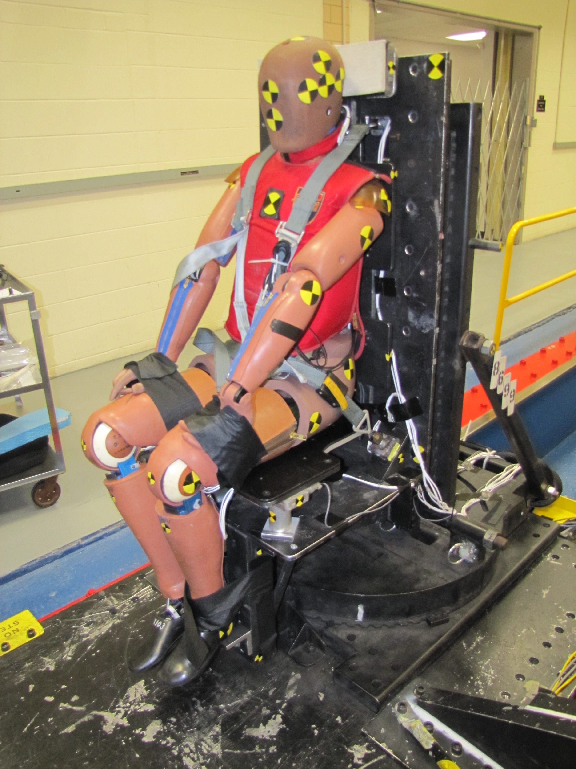
Euro NCAP MPDB
Euro NCAP | 2020
Full Vehicle Crash Test
PURPOSE
Simulates head-on between similar vehicles. Uniquely measures 'aggressivity' - how much damage test vehicle inflicts on other car.
TEST SETUP
DUMMY & INSTRUMENTATION
Test Vehicle Speed: 50 km/h (31 mph)
Trolley Speed: 50 km/h
Overlap: 50%
Trolley Mass: 1,400 kg
Barrier: Progressive deformable
Driver ATD: THOR-50M
Rear ATDs: Q6, Q10 children
THOR Features: 150+ channels
Special: Multi-point chest
INJURY CRITERIA & LIMITS
Occupant Protection: Injury scores (Primary)
Compatibility: Barrier deformation (Unique)
Penalty: Aggressive vehicles penalized (Modifier)
Note: THOR-50M: Most advanced frontal dummy in use.

Slide 24
SECTION 4: PEDESTRIAN PROTECTION
Tests in This Section:
1. Euro NCAP Pedestrian - Legform Impact
2. Euro NCAP Pedestrian - Headform Impact
3. Euro NCAP AEB Pedestrian/Cyclist

Slide 25
Euro NCAP Pedestrian - Legform Impact
Euro NCAP | 1997
Component Test
PURPOSE
Evaluates bumper design for pedestrian leg injuries. Bumper typically contacts leg first when vehicle strikes pedestrian.
TEST SETUP
DUMMY & INSTRUMENTATION
Impactor: Flexible lower legform
Impact Speed: 40 km/h (25 mph)
Target: Front bumper
Test Points: Multiple across width
Upper Leg Mass: 8.6 kg
Knee Sensors: Angle, shear
Tibia Sensors: Accel, bending
Total Mass: 13.4 kg
INJURY CRITERIA & LIMITS
Knee Bending: ≤15° good, ≥21° poor (Angle)
Knee Shear: ≤3.5mm good, ≥6mm poor (Displacement)
Tibia Accel: ≤150g good, ≥200g poor (Acceleration)

Slide 26
Euro NCAP Pedestrian - Headform Impact
Euro NCAP | 1997/2023
Component Test
PURPOSE
Evaluates hood/windshield design for pedestrian head injuries. Hood surface and windshield base are where pedestrians' heads typically strike.
TEST SETUP
DUMMY & INSTRUMENTATION
Impact Speed: 40 km/h (25 mph)
Adult Headform: 4.5 kg, 165mm
Child Headform: 3.5 kg, 130mm
Target: Hood, windshield base
Test Points: Grid of locations
Sensors: Triaxial accelerometer
Channels: 3 per impact
Filter: CFC 1000
INJURY CRITERIA & LIMITS
HIC15 Good: ≤ 650 (Green)
HIC15 Adequate: 650-1000 (Yellow)
HIC15 Poor: ≥ 1700 (Red)
Note: Led to raised hoods, pop-up systems, external airbags.

Slide 27
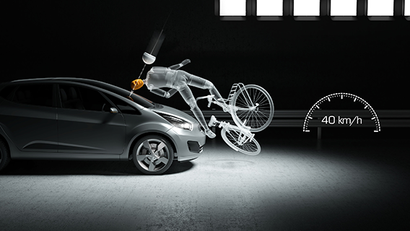
Euro NCAP AEB Pedestrian/Cyclist
Euro NCAP | 2016/2018/2024
Track Test
PURPOSE
Evaluates active systems that detect and brake for pedestrians/cyclists. 2024 update added night testing for pedestrians.
TEST SETUP
DUMMY & INSTRUMENTATION
Adult Crossing: CPFA, CPNA scenarios
Adult Along Road: CPLA scenario
Child Running: CPNC scenario
Cyclist: CBFA, CBLA scenarios
Speeds: 20, 40, 60 km/h
Targets: Adult/child body forms
Cyclist: Bike + rider target
2024 Update: Night testing added
INJURY CRITERIA & LIMITS
Full Avoidance: Maximum points (Best)
Speed Reduction: Partial points (Good)
Warning Only: Minimal points (Basic)
No Response: Zero points (Fail)

Slide 28
SECTION 5: SPORTS / HELMET TESTING
Tests in This Section:
1. NOCSAE Football Helmet - Drop Test
2. NOCSAE Football Helmet - Linear Impactor
3. NOCSAE Lacrosse Helmet
4. Ice Hockey Helmet (ASTM/HECC/CSA)
5. FMVSS 218 - Motorcycle Helmet

Slide 29
NOCSAE Football Helmet - Drop Test
NOCSAE | 1973
Drop Test
PURPOSE
Ensures helmets attenuate impact energy to prevent skull fracture and severe brain injury. Founding test that reduced football fatalities by 90%.
TEST SETUP
DUMMY & INSTRUMENTATION
Standard Drop: 60 inches (152 cm)
Additional Heights: 36, 48, 72 inches
Headform: Humanoid (rigid)
Anvils: Flat, hemi, edge
Temps: Ambient, hot, cold
Sensors: Triaxial accelerometer
Sample Rate: ≥ 10,000 Hz
Filter: CFC 1000
INJURY CRITERIA & LIMITS
SI Limit: < 1200 (All conditions)
Drop Sequence: Front, side, rear, top (60 inch)
Conditioning: Multiple impacts (Per protocol)
Note: Pre-1973: 32 deaths/yr. Post-standard: ~3/yr (90% reduction).

Slide 30
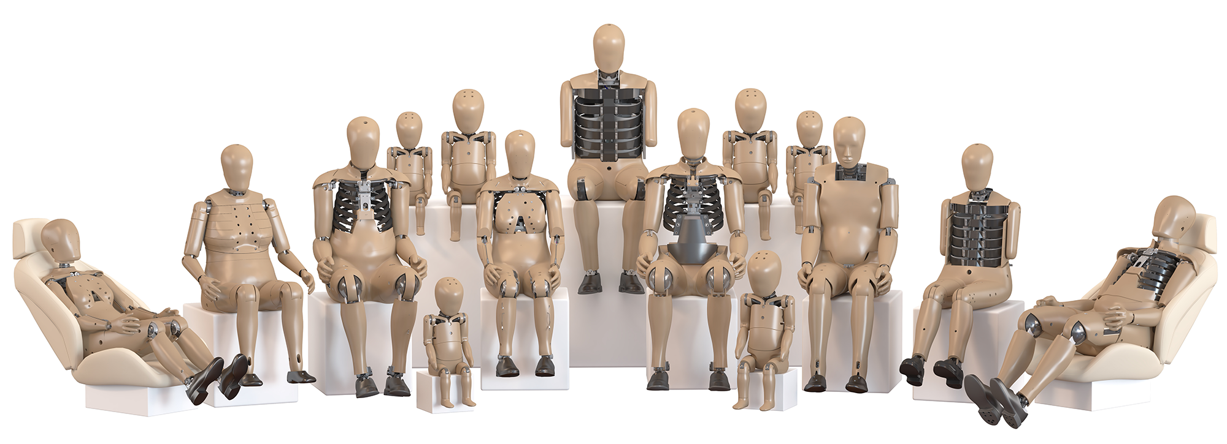
NOCSAE Football - Linear Impactor
NOCSAE | 2016
Ram Impact Test
PURPOSE
Evaluates oblique impacts causing rotational acceleration - linked to concussions. Supplements drop tests to address rotational brain injury.
TEST SETUP
DUMMY & INSTRUMENTATION
Impactor: Pneumatic ram
Ram Mass: ~13 kg
Impact Speed: 5.5-9.3 m/s
Locations: Multiple angles
Headform: Hybrid III head/neck
Linear Accel: 3-axis accelerometer
Rotational Accel: Angular rate sensors
Rotational Velocity: Calculated
INJURY CRITERIA & LIMITS
Peak Linear: Brain injury risk (Linear)
Peak Rotational: Concussion risk (Rotational)
Velocity: Brain strain (Rotational)
Note: NFL/NFLPA uses combined data for helmet rankings.

Slide 31
NOCSAE Lacrosse Helmet
NOCSAE | ND041
Drop + Projectile
PURPOSE
Protects against collision and ball impacts. Combines impact attenuation with projectile protection from high-speed lacrosse ball.
TEST SETUP
DUMMY & INSTRUMENTATION
Drop Heights: 60, 48, 36 inches
Headform: Humanoid
Anvils: Flat, hemispherical
Ball Speed: 45 mph (20 m/s)
Ball Targets: Faceguard and shell
Sensors: Triaxial accelerometer
Sample Rate: ≥ 8,000 Hz
Filter: CFC 1000
INJURY CRITERIA & LIMITS
Drop SI: < 1200 (Impact attenuation)
Ball SI: < 1200 (Projectile)
Penetration: None allowed (Faceguard)

Slide 32
Ice Hockey Helmet
HECC/CSA/ASTM | Multiple
Drop + Puck
PURPOSE
Protects against falls, collisions, and puck impacts (100+ mph). Must allow facemask integration. Multiple international standards.
TEST SETUP
DUMMY & INSTRUMENTATION
Drop Heights: 1.5m, 2.0m
Headform: ISO/CSA specified
Anvils: Flat, hemi, edge
Puck Mass: 170g (official)
Puck Speed: 25-40 m/s
Standards: CSA, ASTM, HECC, CE
Sensors: Triaxial accelerometer
Primary: Peak g measurement
INJURY CRITERIA & LIMITS
Drop Flat: Peak < 275g (CSA)
Drop Hemi: Peak < 275g (CSA)
Puck Impact: No fracture (Shell)
Facemask: No penetration (Puck)

Slide 33
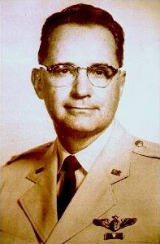
FMVSS 218 - Motorcycle Helmet
NHTSA | 1968
Drop + Penetration
PURPOSE
Minimum requirements for motorcycle helmets (DOT certification). Every street-legal helmet must pass. Snell and ECE exceed DOT.
TEST SETUP
DUMMY & INSTRUMENTATION
Drop Height: 1.83m (flat), 1.38m (hemi)
Anvils: Flat, hemispherical
Headforms: ISO (multiple sizes)
Conditioning: Ambient, hot, cold, wet
Penetration: 3kg cone from 3m
Sensors: Accelerometer
Primary: Peak acceleration
Penetration: Contact detection
INJURY CRITERIA & LIMITS
Peak Accel: ≤ 400g (DOT)
Penetration: No headform contact (Pass/Fail)
Snell M2020: 275g (voluntary) (Stricter)
ECE 22.06: Includes rotational (Europe)
Note: DOT is minimum; Snell and ECE exceed requirements.

