Slide 1
Data Saves Lives
The Story of Safety Testing:
How We Decided to Do Better

Slide 2
77%
Reduction in traffic fatality rate since 1970
1970: 4.74 deaths per 100M miles | Today: 1.10 deaths per 100M miles
If we still had 1970 rates: 153,000 deaths per year instead of 36,000

Slide 3
The Pattern: Every Test Has a Story
Every crash test exists because people were dying in a specific way
And at some point, we decided that was unacceptable.
The cycle repeats throughout history:
  TRAGEDY: People die in ways we don't understand
  DECISION: We decide we need to do better
  DATA: Testing reveals the mechanism of injury
  STANDARD: A test is created to measure the problem
  ENGINEERING: Manufacturers design solutions
  LIVES SAVED: That specific death mode decreases
This presentation traces that cycle across 10 test modes.

Slide 4
"We chose to stop accepting preventable deaths as inevitable."
-- The philosophy shift that created modern safety testing

Slide 5
The Foundation: SAE J211
Before we could save lives, we had to agree on how to measure them

Slide 6
The Problem: Data Without Standards
In the early days of crash testing, every lab was an island:
  Different equipment, different filters, different sampling rates
  Data from GM couldn't be compared to data from Ford
  The same crash could produce wildly different numbers
Raw accelerometer data is full of noise:
  Structural resonance from the vehicle
  Electrical interference
  High-frequency artifacts that don't represent human injury
Without standards, crash test data was essentially meaningless.
We decided we needed a common language.

Slide 7
The Solution: Channel Frequency Classes (CFC)
SAE J211 (1971) and ISO 6487 created the common language:
CFC 1000 (1000 Hz): Head acceleration
  Brain injuries happen fast - need high bandwidth
CFC 600 (600 Hz): Chest and pelvis acceleration
  Torso responds slower than head
CFC 180 (180 Hz): Structural measurements
  Vehicle deformation, barrier loads
4th-order Butterworth low-pass filter specification
  Removes noise without distorting the injury signal
SAE J211-1 Rev. 2014 | ISO 6487:2015 - technically equivalent standards

Slide 8
How DTS Helps: J211 Compliance
Every DTS data acquisition system is built to SAE J211 / ISO 6487 specs:
Hardware anti-aliasing filters prevent signal contamination
Software implements exact Butterworth filter specifications
Calibration traceable to J211 requirements
Sample rates exceed requirements: up to 100 kHz per channel
Data from any DTS system is comparable to data from any other
DTS system worldwide - enabling global safety research collaboration
DTS Products: SLICE6, SLICE NANO, SLICE MICRO, TDAS G5

Slide 9
Test Mode 1: FMVSS 208
The 28-year war: Industry fought airbags from 1970 until mandatory in 1998

Slide 10
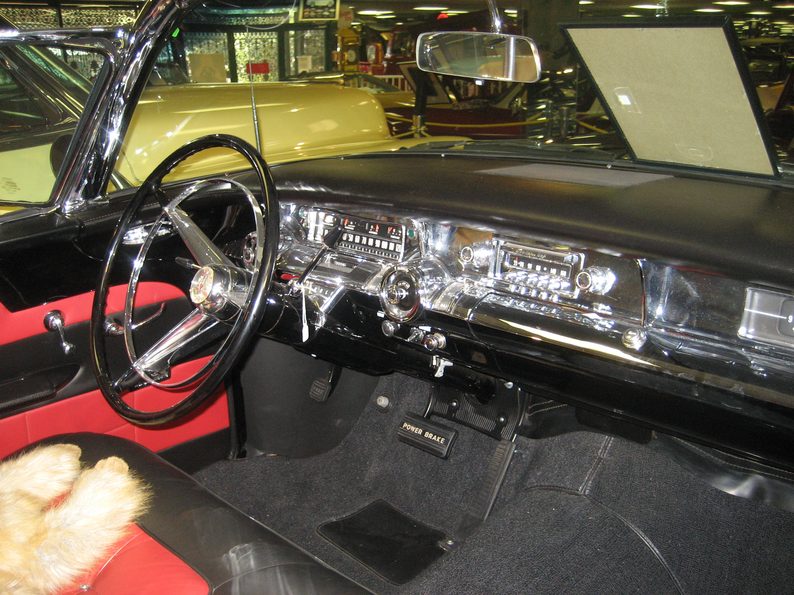
Before 1968: The Dark Age
No federal safety requirements existed for occupant protection
Seatbelts were optional accessories - rarely ordered
Steering columns were rigid metal shafts pointed at driver's chest
  By 1964: over 1 MILLION cumulative steering column deaths
Dashboards were solid steel with chrome protrusions
Industry position: 'Crashes are caused by bad drivers, not bad cars'
At some point, we decided that 50,000 deaths per year
was not acceptable.

Slide 11
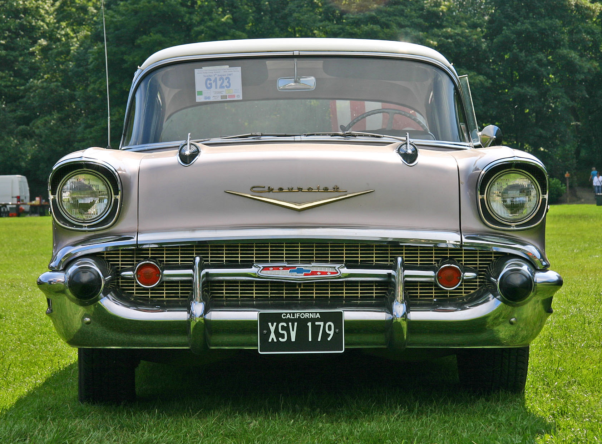
Styling Over Safety: 1957
Chrome, steel, and style. No seatbelts, no airbags, no crumple zones.

Slide 12
The Airbag Wars: 28 Years of Fighting
1968
FMVSS 208 takes effect - requires seatbelt anchorages only
1970
NHTSA proposes airbag requirement
1972
GM offers airbags on Oldsmobiles - few buyers
1977
Joan Claybrook (NHTSA) pushes airbag mandate
1981
Reagan administration RESCINDS airbag mandate
1983
Supreme Court rules rescission was arbitrary
1984
Compromise: 'automatic restraint' required
1990
First airbag fatality - a child in front seat
1997
53 deaths from airbag deployment - peak year
1998
FINALLY: Frontal airbags mandatory - 28 years later

Slide 13
The Depowering Crisis: When Airbags Killed
Early airbags were designed for one scenario:
  Unbelted adult male
  Maximum deployment force in every crash
Problem: What about children? Small adults sitting close?
1990: First airbag fatality - a child
1996-1997: 53 deaths from airbag deployment
  Victims: mostly children in front seats, small women
The data showed the problem. Better data gave us the fix:
  'Depowered' airbags with lower inflation force
  Weight sensors detect occupant size
  Suppression systems for small occupants
We decided that protecting one group couldn't mean killing another.

Slide 14
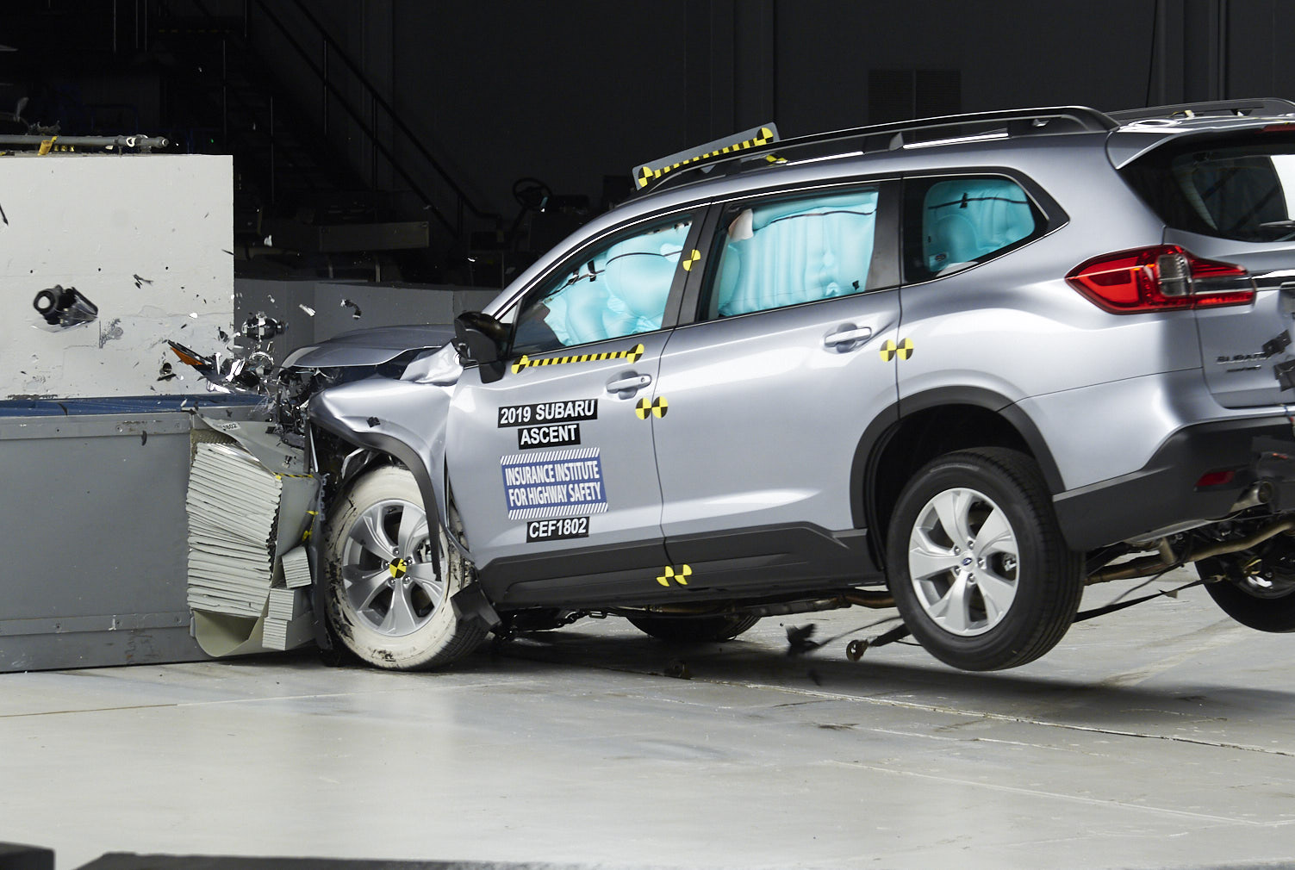
FMVSS 208: Technical Specifications
Test Configuration:
  30 mph full frontal barrier (compliance)
  35 mph full frontal barrier (NCAP consumer rating)
Dummies:
  Hybrid III 50th percentile male (driver)
  Hybrid III 5th percentile female (passenger)
  Total: ~94 channels (47 per dummy)
Key Injury Criteria:
  HIC15 < 700 (head injury)
  Chest acceleration 3ms < 60g
  Chest deflection < 63mm (50th male)
  Femur load < 10 kN

Slide 15
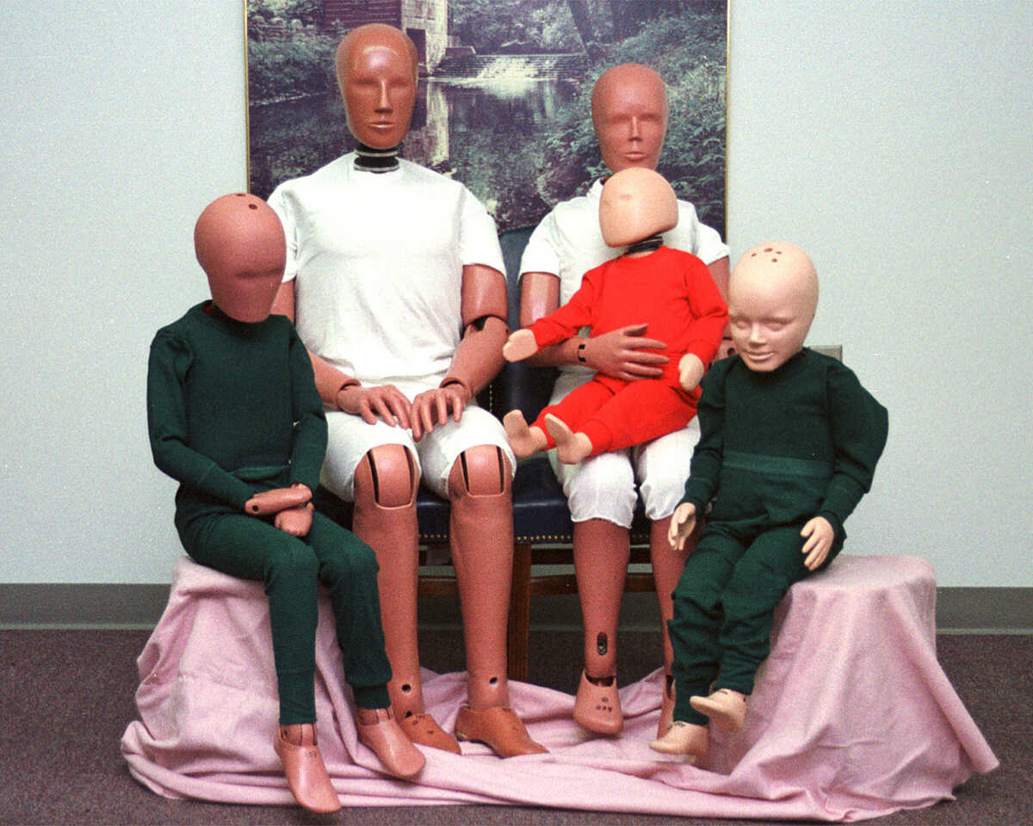
The Hybrid III Family
Introduced 1976 - still the global standard for frontal impact
Family of sizes representing different populations:
  95th percentile male (6'2", 220 lbs)
  50th percentile male (5'9", 172 lbs) - most common
  5th percentile female (5'0", 110 lbs)
  10-year-old child
  6-year-old child
  3-year-old child
Each dummy is a mechanical body.
DTS provides the 'nervous system' - the sensors that feel.

Slide 16
How DTS Helps: FMVSS 208
Head: Triaxial accelerometer (CFC 1000)
- Measures peak deceleration for HIC calculation
Chest: Accelerometer + deflection potentiometer (CFC 600)
- Chest compression indicates rib/organ injury risk
Neck: 6-axis load cell
- Forces and moments for Nij calculation
Femur: Uniaxial load cells (both legs)
- Dashboard/knee bolster loading
Every channel matters - one sensor failure = repeat the $500K test
DTS Products: SLICE6, 6DX PRO-A (6 degrees of freedom), TDAS G5

Slide 17
Video: IIHS 1959 vs. 2009 Crash Test
VIDEO
IIHS 50th anniversary demonstration: 1959 Chevy Bel Air vs. 2009 Chevy Malibu at 40 mph. The most powerful demonstration of 50 years of safety progress. (1:43)
https://www.youtube.com/watch?v=joMK1WZjP7g

Slide 18
Test Mode 2: IIHS Small Overlap
When BMW, Mercedes, and Audi all failed: The test that humiliated luxury cars

Slide 19
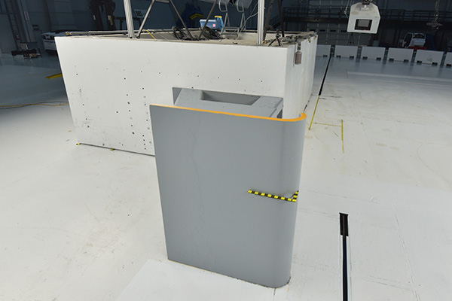
The Gap: What Existing Tests Missed
By 2012, vehicles performed well in:
  NHTSA NCAP full frontal (100% overlap)
  IIHS moderate overlap (40% overlap)
But IIHS researchers noticed something in real-world crash data:
  Fatal frontal crashes still occurring in 'safe' cars
  Many involved narrow overlap - trees, poles, vehicle corners
The problem with 25% overlap:
  Main structural frame rails are NOT engaged
  Forces go through wheel and suspension into footwell
  Wheel can be pushed into occupant compartment
We decided that 'good enough' on existing tests wasn't good enough.

Slide 20
Small Overlap Test (2012): The Shock
What Failed
What It Revealed
BMW 3 Series - MARGINAL
Mercedes C-Class - MARGINAL
Audi A4 - MARGINAL
Lexus IS - MARGINAL
Lexus ES - MARGINAL
Lincoln MKZ - POOR
Buick Regal - POOR
Volkswagen CC - POOR
These were LUXURY vehicles that
earned top marks in every other test.
A-pillars folded on impact
Footwells crushed by wheel intrusion
Occupants slid toward the gap
Restraint systems couldn't compensate
Structures had been optimized for
40% and 100% overlap tests.
No one had tested 25%.
The small overlap exposed a
critical structural blind spot.

Slide 21
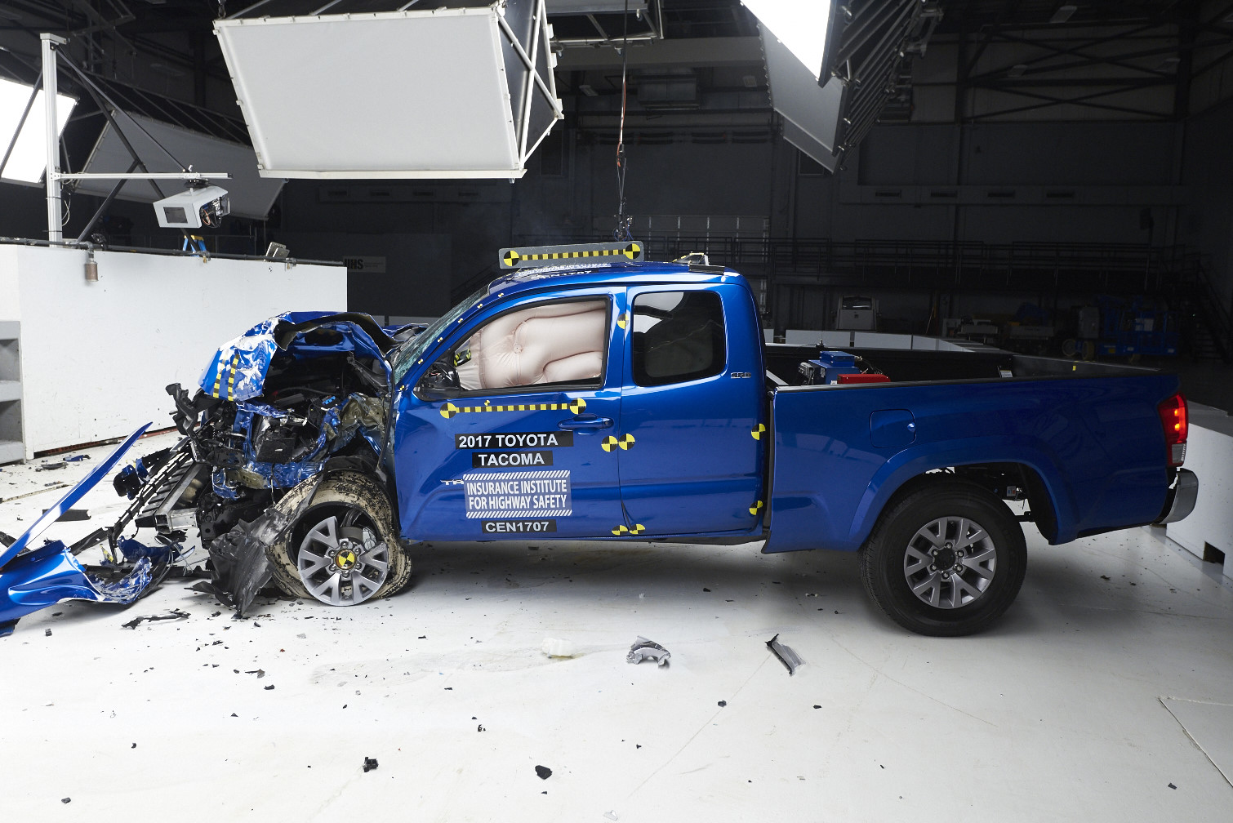
The Industry Response
Initial reaction: 'The test isn't realistic!'
Then: Rapid engineering scramble
  Structural members added outboard of frame rails
  A-pillar and hinge pillar connections reinforced
  Firewall 'blocking' structures to redirect forces
  Wheel well reinforcement
Timeline:
  2012: Most vehicles Poor or Marginal
  2014: Mixed results - some manufacturers improve
  2016: Most new designs earn Good
  2017: IIHS adds PASSENGER side test (prevent gaming)
Five years. From widespread failure to widespread success.

Slide 22
How DTS Helps: Small Overlap
The most demanding frontal test requires the most reliable data:
Head trajectory tracking:
- Where does the occupant's head go during the crash?
- Critical for assessing curtain airbag effectiveness
Chest kinematics:
- Did the restraint system keep occupant in position?
- Or did they slide toward the gap?
Lower extremity loads:
- Wheel intrusion into footwell is a signature failure mode
- Tibia axial force and bending moment measurements
Every channel tells part of the story.
DTS Products: SLICE6, SLICE NANO, ACC3 PRO-A accelerometers

Slide 23
Test Mode 3: FMVSS 301
The $11 fix Ford refused to make: The memo that led to criminal prosecution

Slide 24
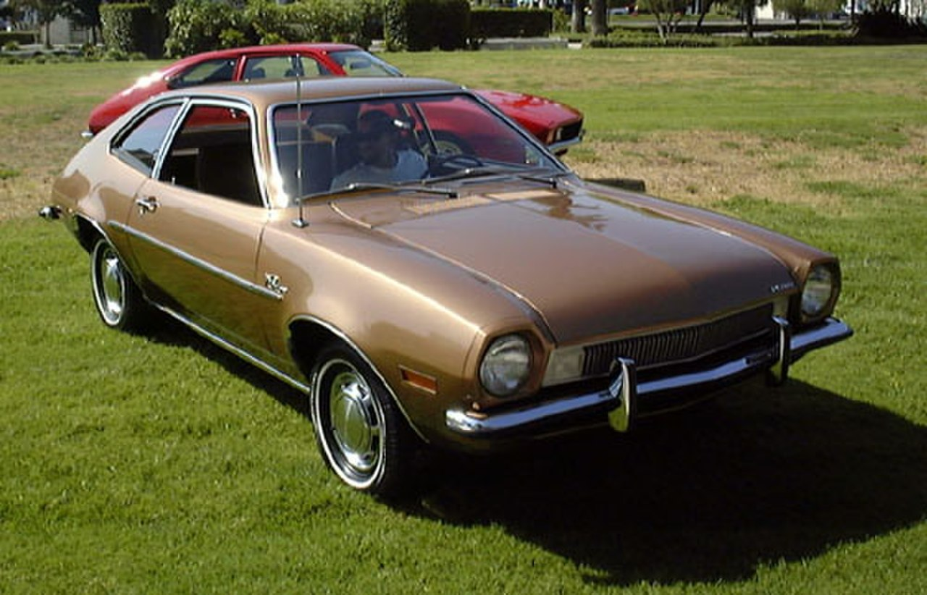
The Ford Pinto: A Design Decision
1970: Ford introduces the Pinto - subcompact to compete with imports
The fuel tank design:
  Located behind rear axle, 6 inches from bumper
  Minimal protection from rear impact
  Bolts on differential could puncture tank in collision
  Fuel filler neck could separate, spilling fuel
Ford engineers knew about the vulnerability
  Crash tests showed fuel leakage in rear impacts
  Design fixes were identified and costed
But the Pinto was already in production...

Slide 25
The Memo: Cost-Benefit Analysis (1973)
Ford's internal calculation:
COST TO FIX:
  $11 per vehicle x 12.5 million vehicles = $137 million
COST OF NOT FIXING (estimated):
  180 deaths x $200,000 per death = $36 million
  180 serious injuries x $67,000 = $12 million
  2,100 burned vehicles x $700 = $1.5 million
  Total: $49.5 million
FORD'S DECISION: Do not implement the fix.
We decided that corporate cost-benefit analysis
could not override the value of human life.

Slide 26
The Reckoning
1977: Mother Jones publishes 'Pinto Madness' expose
  Internal memo becomes public
  Public outrage follows
1978: NHTSA investigation and recall
  1.5 million Pintos recalled
  FMVSS 301 strengthened in direct response
1978: Indiana v. Ford Motor Company
  First criminal prosecution of an automaker for defective design
  Ford acquitted, but reputation destroyed
Estimated deaths from Pinto fuel system: 27-180
The Pinto case created the template for product liability law.

Slide 27
How DTS Helps: FMVSS 301
Vehicle structure accelerometers confirm impact severity
- Critical for validating that test conditions were met
Barrier load cells measure impact force
- Ensures test is representative of real-world crashes
While fuel leakage is measured directly (not with DTS sensors),
the crash event itself requires precise data acquisition
This test ensures that the progress we've made in
occupant protection isn't undone by post-crash fire.
DTS Products: SLICE PRO, load cell interfaces

Slide 28
Test Mode 4: FMVSS 214 Side Impact
25% of crashes, 30% of deaths: The door that wasn't a barrier

Slide 29
25% / 30%
Side impacts: 25% of crashes but 30% of fatalities
More deadly PER CRASH than frontal. Why? Minimal crush space, no crumple zone, direct loading to torso and head.

Slide 30
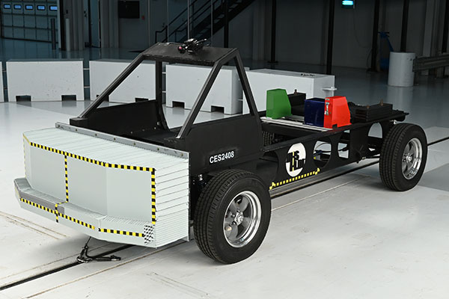
The Neglected Crash Mode
Timeline of neglect:
  1968: FMVSS 208 (frontal protection) - nothing for side
  1973: FMVSS 214 - static door strength only
  1979: NCAP ratings (frontal) - nothing for side
  1990: First DYNAMIC side test (22 years after frontal)
  2003: IIHS side test
  2007: Pole test added (head protection)
Before side airbags, there was NOTHING between
your ribs and the door in a side crash.
We decided that side crash victims deserved the same
engineering attention as frontal crash victims.

Slide 31
The Side Airbag Revolution
Pre-1995
Nothing between your ribs and the door
1995
Volvo introduces first side torso airbag
1998
First side curtain airbags (head protection)
2003
IIHS side test launched - accelerates adoption
2007
FMVSS 214 pole test requires head protection
2010
Side curtain airbags standard on most vehicles
2021
IIHS updates side test: heavier, taller, faster barrier

Slide 32
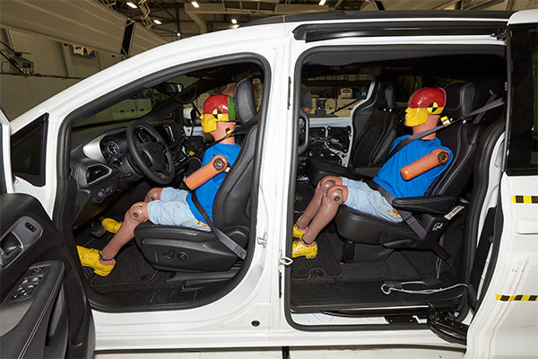
FMVSS 214: Technical Specifications
MDB Test (Moving Deformable Barrier):
  33.5 mph (FMVSS) / 38.5 mph (NCAP)
  Barrier strikes stationary vehicle at 90 degrees
  ES-2re dummy (50th male, side impact design)
Pole Test (added 2007):
  20 mph into 254mm (10 inch) diameter pole
  Simulates tree strike, utility pole
  Specifically targets head protection
Injury Criteria:
  Thoracic Trauma Index (TTI)
  Pelvis acceleration
  Rib deflection (Viscous Criterion)

Slide 33
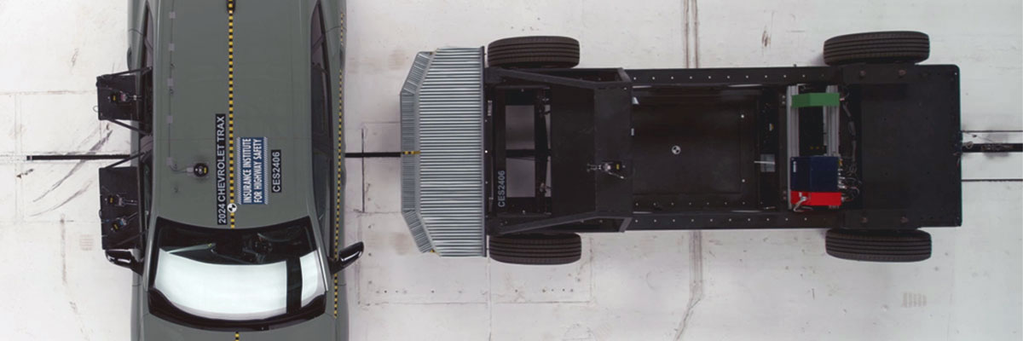
2021: The Updated Side Test
The vehicle fleet changed - tests must change too
SUVs and trucks now dominate sales
  Old barrier simulated an average car
  New barrier simulates modern SUV/truck
Updated barrier specifications:
  Weight: 4,200 lbs (was 3,300 lbs)
  Speed: 37 mph (was 31 mph)
  Profile: Taller to match SUV front ends
Results: Many 'Good' vehicles dropped to lower ratings
Manufacturers redesigning structures AGAIN
The test evolved because the threat evolved.

Slide 34
How DTS Helps: Side Impact
Side impact dummies are fundamentally different from frontal:
- Different rib structure (ribs that deflect laterally)
- Different instrumentation layout
Rib deflection sensors (IR-TRACCs):
- Measure chest compression
- Critical for Viscous Criterion calculation
Multiple accelerometer locations:
- Thorax (upper, middle, lower)
- Pelvis, Head (for pole test)
The pole test head measurements drove universal adoption
of side curtain airbags - now standard equipment.
DTS Products: SLICE6, IR-TRACC interfaces, ES-2re integration

Slide 35
Test Mode 5: FMVSS 216 Roof Crush
36 years unchanged: The 1.5x standard that advocacy finally doubled

Slide 36
3% / 30%
Rollovers: 3% of crashes but 30% of fatalities
Ejection in rollover is 77% fatal. The roof is the last line of defense.

Slide 37
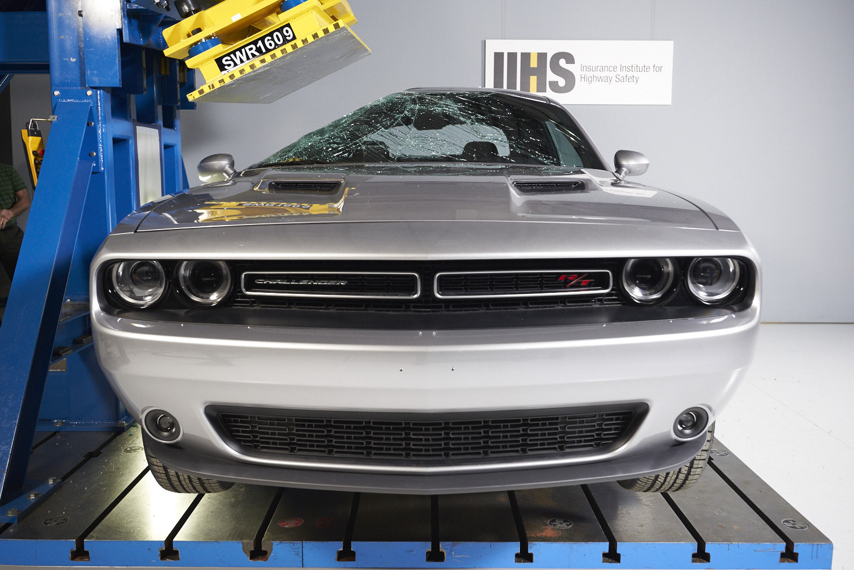
The Long Fight for Stronger Roofs
1973: FMVSS 216 established
  Roof must withstand 1.5x vehicle weight
  Only ONE side tested (driver side)
For 36 YEARS, this standard did not change.
Consumer advocates argued:
  1.5x is far too weak
  Real-world rollovers show roofs collapsing into survival space
  Should be 4x or higher
2009: Standard FINALLY upgraded
  Doubled to 3x vehicle weight
  BOTH sides must be tested
IIHS pushed further: 4x required for 'Good' rating
Many vehicles now achieve 5-6x.

Slide 38
How DTS Helps: Roof Crush
Unlike crash tests, roof strength is a static test:
- Controlled force application
- Force vs. displacement measurement
DTS load cells measure applied force
- High accuracy for force-deflection curve
Displacement sensors track crush distance
- Critical for determining when 127mm threshold is reached
The test determines if occupants have survival space if
the vehicle rolls - the data validates the structure.
DTS Products: SLICE PRO LAB, load cell interfaces

Slide 39
Test Mode 6: IIHS Head Restraint
One million injuries per year: The epidemic hiding in low-speed crashes

Slide 40
The Whiplash Epidemic
Over 1 MILLION whiplash injuries per year in the US
  Most occur in low-speed rear impacts
  Not fatal, but chronic pain can persist for years
  Enormous economic cost: medical, lost work, disability
Early head restraints were ineffective:
  Set too low (didn't support head)
  Too far back from head (head snapped backward before contact)
  Often adjusted incorrectly or removed entirely
Swedish research (Volvo, Saab) led the way:
  'Active' head restraints that move up/forward during crash
  Engage head earlier, reduce relative motion
We decided that non-fatal injuries still matter.

Slide 41
IIHS Whiplash Test: Technical Specifications
Test Method:
  Dynamic sled test (not full vehicle crash)
  Simulates low-speed rear impact
Dummy:
  BioRID II - specifically designed for rear impact
  24 articulated vertebrae (highly flexible spine)
Key Measurements:
  Neck Injury Criteria (NIC)
  Neck forces and moments
  Relative head-to-torso movement
  Seat strength (must not collapse backward)
Active head restraints are now standard equipment
because of this test.

Slide 42
How DTS Helps: Whiplash Testing
BioRID II has a fundamentally different spine than Hybrid III:
- 24 articulated vertebrae vs. rigid lumbar/thoracic
- Requires different instrumentation approach
Sensors along the articulated spine measure relative motion:
- How does each vertebra move relative to adjacent ones?
- This is the mechanism of whiplash injury
Head and torso accelerometers (CFC 1000, CFC 600)
Different dummy = different data acquisition configuration
DTS systems support both Hybrid III and BioRID configurations.
DTS Products: SLICE6, BioRID spine sensor interfaces

Slide 43
Test Mode 7: IIHS Front Crash Prevention
The voluntary revolution: 20 automakers agreed without a government mandate

Slide 44
The Philosophy Shift: Passive to Active
Passive Safety (1968-2000s)
Active Safety (2000s-present)
Assume crash WILL happen
Focus on protection DURING crash:
- Seatbelts
- Airbags
- Structure
After 50 years, we've gotten very good
at protecting people in crashes.
But 94% of crashes involve human error...
Try to PREVENT the crash
Warn driver, assist, brake automatically:
- AEB (Autonomous Emergency Braking)
- ESC (Electronic Stability Control)
- Lane Keeping Assist
If crash is unavoidable, passive kicks in.
Active + Passive = Maximum protection

Slide 45
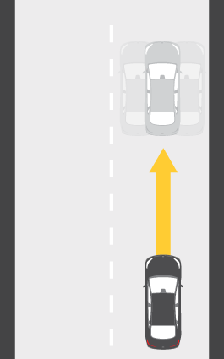
The Voluntary Commitment (2016)
20 automakers voluntarily committed to make AEB standard by 2022:
  No government mandate required
  Driven by IIHS ratings and consumer demand
  The fastest safety technology adoption in history
Effectiveness:
  AEB reduces rear-end crashes by 50%+
  Even basic forward collision warning reduces crashes 27%
This is a fundamentally new type of safety test:
  Not measuring crash protection
  Measuring crash PREVENTION
We decided that preventing crashes is better than surviving them.

Slide 46
How DTS Helps: AEB Testing
This is an expanding market for DTS:
Vehicle dynamics measurement:
- Speed, deceleration, timing
- When did the system activate?
- How quickly did it respond?
Not traditional dummy instrumentation, but related technology:
- High-speed data acquisition
- Precise timing synchronization
The future of safety testing includes evaluating systems
that PREVENT crashes, not just systems that protect in crashes.
DTS Products: TSR AIR data logger, SLICE systems for vehicle dynamics

Slide 47
Test Mode 8: Euro NCAP Pedestrian
Europe's 25-year head start: The US still has no federal standard

Slide 48
The Pedestrian Crisis
While occupant deaths have FALLEN, pedestrian deaths are RISING:
  2009: 4,109 pedestrian deaths
  2019: 6,205 pedestrian deaths
  2022: 7,500+ pedestrian deaths (18% of all traffic deaths)
Why?
  Larger vehicles (SUVs, trucks) dominate sales
  Higher front ends hit torso/head instead of legs
  Distracted driving and walking (phones)
The US approach:
  Test if cars AVOID pedestrians (AEB)
  But NOT what happens if they don't
Europe decided 25 years ago that pedestrians deserved protection too.

Slide 49
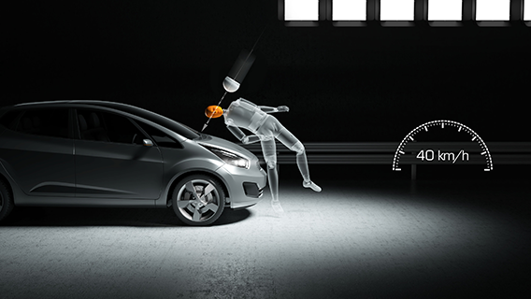
Euro NCAP Pedestrian Testing (Since 1997)
Europe has tested pedestrian protection for 25+ years:
Headform Impactor Test:
  Adult and child headforms
  Fired at hood surface at 40 km/h
  HIC measurement - same physics as occupant head protection
Legform Impactor Test:
  Upper legform: hip/pelvis injury
  Lower legform: knee bending, tibia fracture
Design changes driven by this test:
  Active hood hinges (pop up to create crush space)
  Energy-absorbing bumper structures
  External pedestrian airbags (Volvo)

Slide 50
How DTS Helps: Pedestrian Protection
Headform impactor testing uses DTS accelerometers:
- Same basic technology as crash test dummies
- Triaxial accelerometer inside impactor headform
- CFC 1000 filtering (same as dummy head)
The physics is identical:
- Protect the brain from rapid deceleration
- Whether the brain is inside a car or outside it
Expanding market as US considers pedestrian protection requirements
Same sensors, same data acquisition, different application.
DTS Products: SLICE NANO, ACC3 PRO-A accelerometers

Slide 51
Test Mode 9: NOCSAE Football Helmet
36 deaths in one year: The 1968 season that created helmet certification

Slide 52
The 1968 Crisis
1968: 36 football players died
  Worst year on record for football fatalities
  Most from head and neck injuries
The problem:
  No helmet standards existed
  Manufacturers made their own claims
  No way to verify protection level
  No consistent test method
1969: NOCSAE founded
  National Operating Committee on Standards for Athletic Equipment
  Response to Congressional pressure after 36 deaths
We decided that athletes deserved the same scientific
protection as drivers.

Slide 53
NOCSAE Helmet Standard (1973)
First helmet certification standard:
Drop Tower Test:
  Helmet on headform dropped from 60 inches onto anvils
  Multiple impact locations
  Hot, cold, wet conditions
  Severity Index must be below 1200
Key insight: Same physics as automotive
  SI (Severity Index) closely related to HIC
  Both measure head acceleration over time
  Both derive from Wayne State cadaver research
1978: NCAA mandates NOCSAE-certified helmets
1980: High school (NFHS) mandates NOCSAE helmets

Slide 54
90%
Reduction in football fatalities since NOCSAE standards (1973)
1960s: 26 deaths/year | 1970s: 15 deaths/year | 2010s: 3 deaths/year

Slide 55
How DTS Helps: Helmet Testing
DTS accelerometers inside helmet headforms:
- Same sensors used in automotive crash test dummies
- Triaxial measurement for SI calculation
The injury threshold (SI < 1200) derives from the same
human tolerance research as automotive HIC.
Wayne State cadaver research from the 1950s-60s
informs both automotive and helmet standards.
One technology, one data acquisition approach,
applied across automotive, football, hockey, cycling, equestrian.
DTS Products: SLICE NANO, SLICE MICRO for headform instrumentation

Slide 56
Test Mode 10: NFL Helmet / CTE
The league that denied brain damage: From Mike Webster to $765 million

Slide 57
The Denial
2002: Mike Webster dies at 50 - 'Iron Mike', Hall of Fame center
  Homeless, cognitively impaired, heart attack
2005: Dr. Bennet Omalu publishes first CTE case in NFL player
  Chronic Traumatic Encephalopathy found in Webster's brain
  NFL's response: Demanded retraction, attacked Omalu
2009: NFL finally acknowledges concussion problem
2011: $765 million settlement with former players
The science was clear: Repeated head impacts cause brain damage
  Even 'subconcussive' hits accumulate
We decided that athlete brain health couldn't be ignored for profit.

Slide 58
The Evolution of Helmet Testing
Traditional NOCSAE drop test:
  Measures linear acceleration
  Pass/fail at SI < 1200
Modern research suggests rotation matters more:
  Brain injury may be caused more by ROTATION than linear force
  Concussion mechanism involves brain twisting inside skull
NFL/NFLPA Helmet Testing Protocol:
  Drop tower test (traditional)
  Linear impactor test (game-realistic, higher speeds)
  Pendulum impactor
  Rotational measurements (emerging)
Annual helmet rankings published - creates market pressure

Slide 59
How DTS Helps: Concussion Research
Same accelerometers as automotive head measurement:
- Triaxial linear acceleration
- CFC 1000 filtering
Angular rate sensors for rotational measurement:
- ARS PRO angular rate sensors
- 6DX PRO-A for 6 degrees of freedom
The injury threshold science came from automotive research:
- Wayne State cadaver studies
- HIC development
- Human tolerance curves
DTS instruments both domains with the same technology.
DTS Products: SLICE systems, ARS PRO, 6DX PRO-A, ACC3 PRO-A

Slide 60
The Work Continues
What gaps remain?

Slide 61
Every Test Exposed What Previous Tests Missed
1968: FMVSS 208 (frontal) - but side crashes were neglected
1990: FMVSS 214 (side) - but offset frontal was missed
1995: IIHS Moderate Overlap - but small overlap was missed
2012: IIHS Small Overlap - but passenger side was 'gamed'
2017: Small Overlap Passenger - but fleet changed (bigger SUVs)
2021: Updated Side Test - but gaps remain...
What's NEXT?
  Rear seat occupant protection (currently neglected)
  Far-side impacts (opposite side from impact)
  Vehicle compatibility (small cars vs. large trucks)
  EV-specific tests (battery safety, mass distribution)
The cycle continues. We will keep deciding to do better.

Slide 62
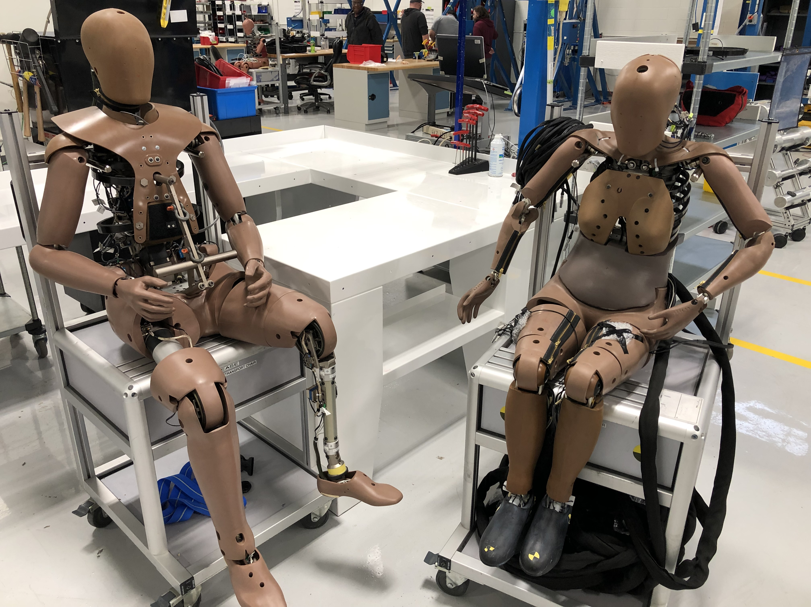
The Gender Gap in Crash Testing
Most crash tests use 50th percentile male dummy (5'9", 175 lbs)
'Small female' dummy is just a SCALED-DOWN male
The consequences:
  Women are 17% more likely to DIE in equivalent crashes
  Women are 73% more likely to be seriously injured
Why?
  Female anatomy differs: hip structure, neck strength
  Women sit closer to steering wheel (shorter legs)
  Seatbelt geometry optimized for male torsos
The solution (in progress):
  THOR-5F (2023): First 'true female' dummy
  Not a scaled male - different skeletal structure
We are deciding that 'average' can't mean 'male' anymore.

Slide 63
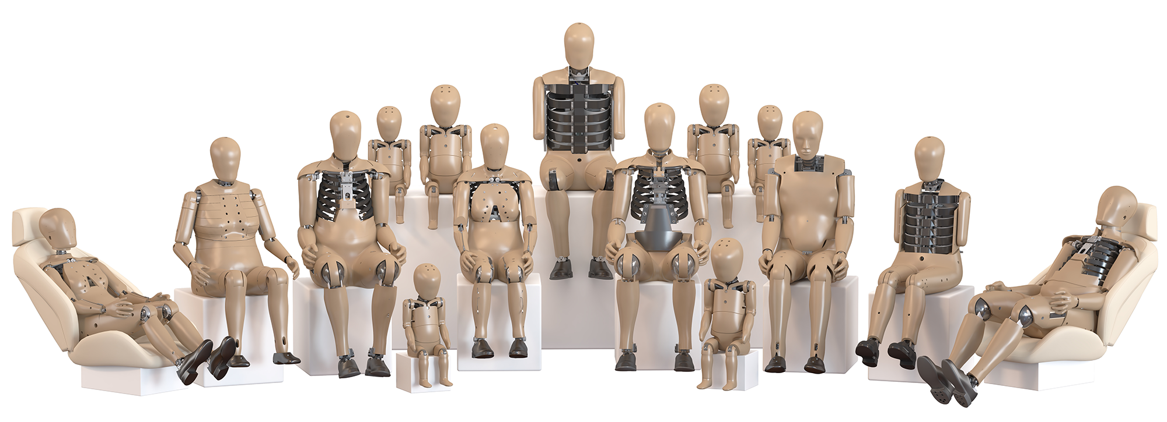
The ATD Evolution
1949: Sierra Sam - first crash test dummy (USAF ejection seats)
1976: Hybrid III - still the global standard, ~47 channels
2013: THOR-50M - 150+ channels, more biofidelic
2015: WIAMan - military blast dummy (DTS partnership)
2023: THOR-5F - first true female dummy
The trend: More biofidelic, more instrumentation, more data
Channel count matters:
  More channels = more data = better understanding
  Better understanding = smarter engineering = more lives saved
DTS provides the nervous system that gives dummies their 'senses'.

Slide 64
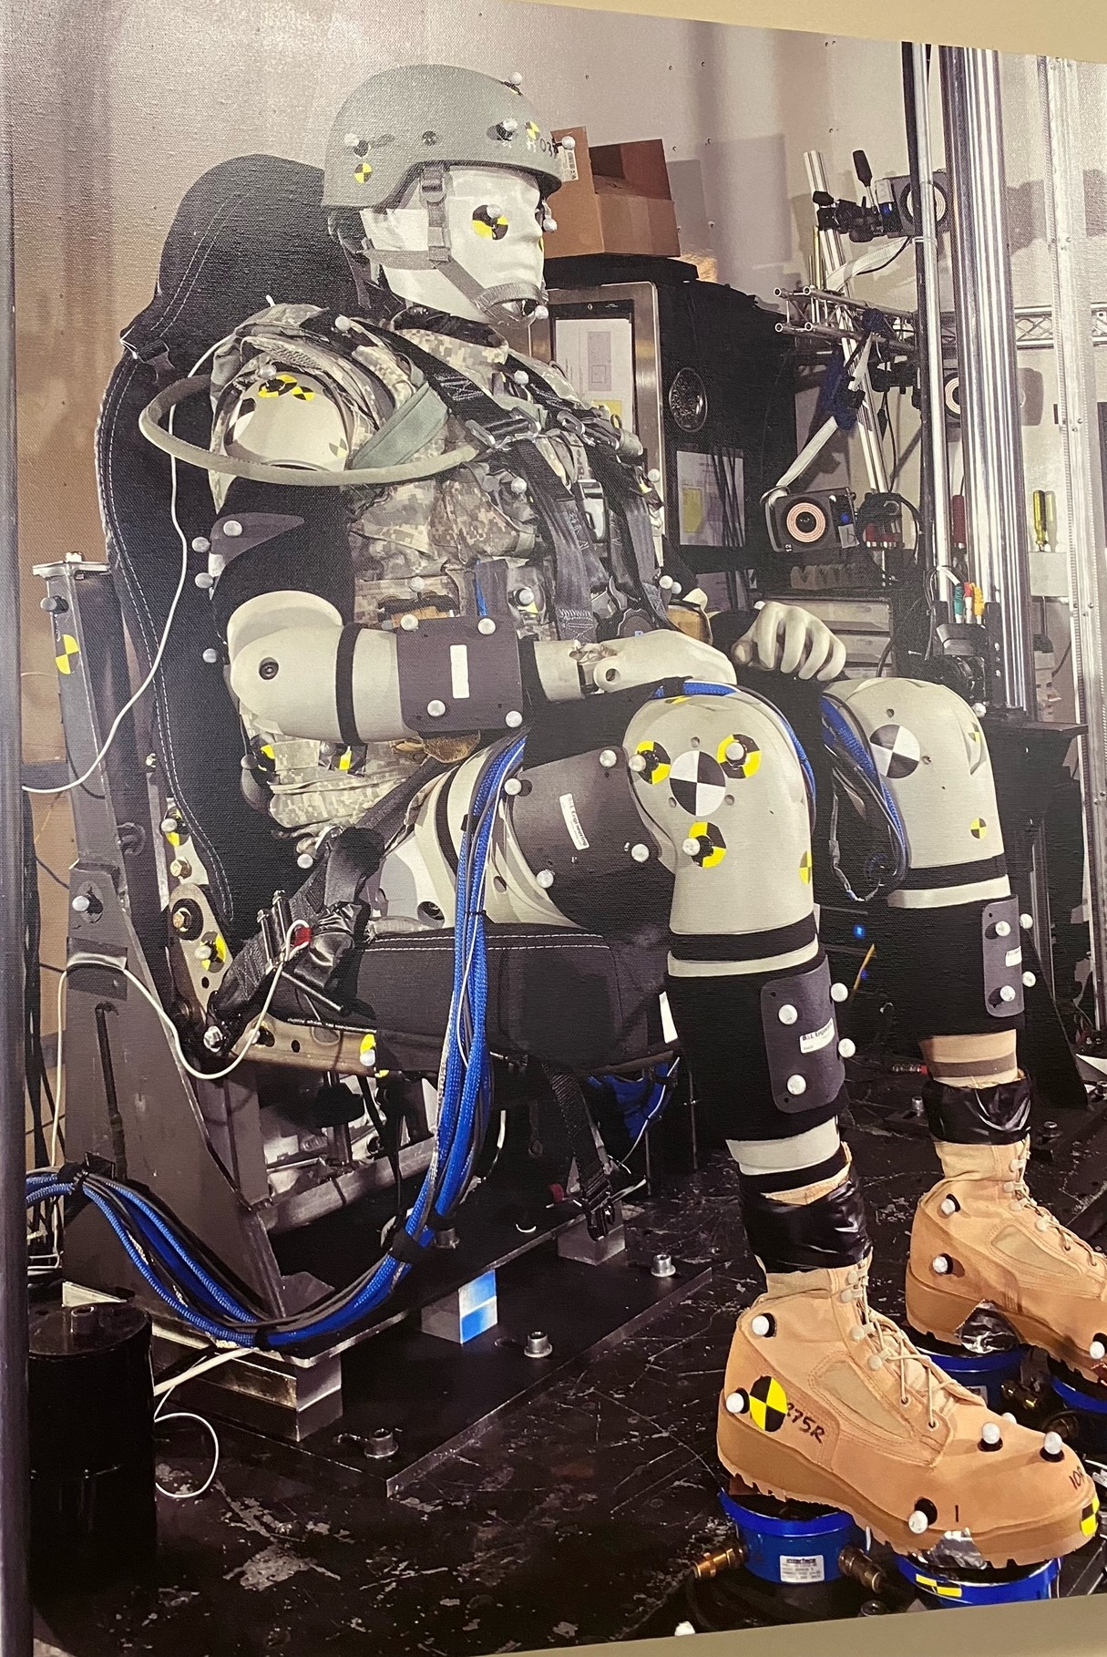
WIAMan: DTS Partnership for Military Safety
Warrior Injury Assessment Manikin - developed with DTS for underbody blast testing

Slide 65
"A crashed car is gone forever. The data is what remains."
-- Industry saying

Slide 66
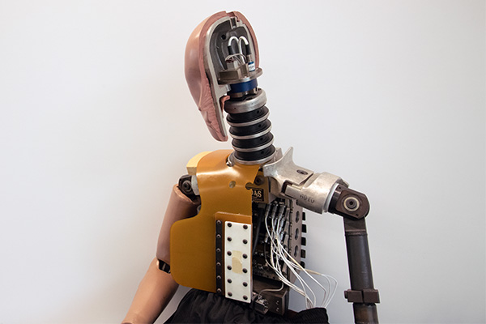
Why Data Quality Matters
A single crash test costs $50,000 - $500,000+:
  Test vehicle: $30,000 - $80,000 (destroyed)
  ATD (Hybrid III 50th): $200,000 - $400,000
  ATD (THOR): $500,000 - $800,000
  Facility, personnel, analysis
The vehicle is destroyed in 100 milliseconds.
ALL VALUE is captured in the data.
If a sensor fails, if a channel drops, if data is questionable:
  You might have to repeat the entire test
  $100K+ repeat cost, weeks of delay
DTS data acquisition is a fraction of test cost
but captures 100% of the value.

Slide 67
117,000
Lives saved per year compared to 1970 rates
1970 rate applied to today's VMT: 153,000 deaths | Actual: 36,000 | Difference: 117,000

Slide 68
Each of Those Lives Was Saved By:
A TRAGEDY that revealed a problem
  Steering column deaths, Pinto fires, football fatalities
A DECISION that we needed to do better
  Congress, NHTSA, IIHS, NOCSAE, consumers demanding change
DATA that revealed the mechanism of injury
  Cadaver research, rocket sled tests, crash tests
A TEST that measured the problem
  FMVSS 208, IIHS Small Overlap, NOCSAE drop test
ENGINEERING that solved it
  Seatbelts, airbags, crumple zones, helmets
DTS is in this chain - capturing the data that drives solutions.

Slide 69
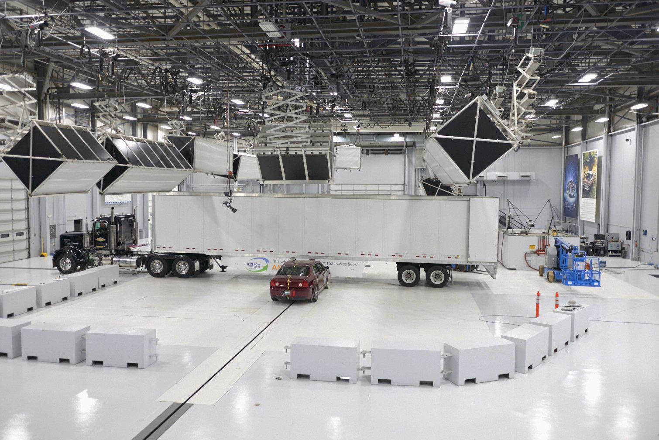
The Culture DTS Was Built On
DTS was founded to serve this mission:
  Innovative solutions for crash test data acquisition
  Reliability when every data point matters
  Accuracy that engineers can trust
This isn't just a business. It's life-saving work.
When NHTSA runs a compliance test - DTS captures the data.
When IIHS rates a vehicle - DTS captures the data.
When a university studies injury biomechanics - DTS captures the data.
When the NFL tests helmet safety - DTS captures the data.
We help the people who decided to do better
actually measure whether they succeeded.

Slide 70
Data Saves Lives
Every test has a story. Every story started with tragedy.
Every tragedy ended when we got the data to understand it.

Slide 71
Questions?
DTS: The data that makes safety testing possible.

